Slide 1
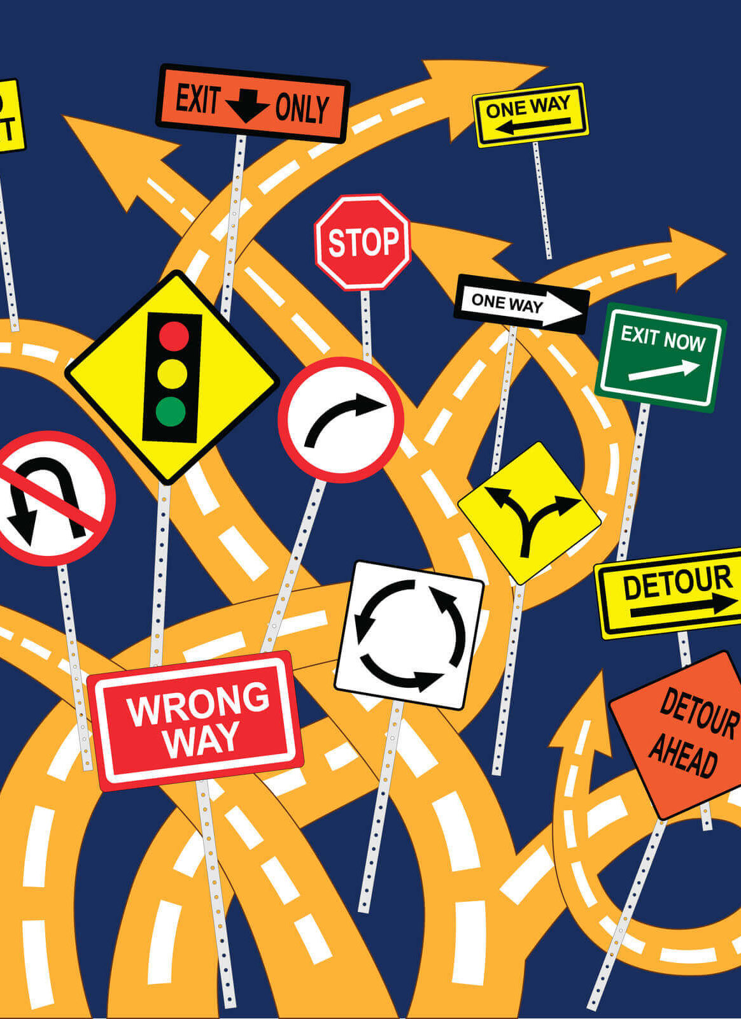
American Rescue Plan Act of 2021 Coronavirus State and Local Fiscal Recovery Fund: THE BASICS
Kara A. Millonzi, Robert W. Bradshaw, Jr. Distinguished Professor of Public Law and Government, UNC Chapel Hill School of Government
millonzi@sog.unc.edu
Rebecca Badgett, Assitant Teaching Professor of Public Law and Government, UNC Chapel Hill School of Government
badgett@sog.unc.edu

Slide 2
The Basics
Counties & Metropolitan Cities (over 50K population)
Distribution directly from US Treasury, based on population
Nonentitlement Units of Local Government
(all other municipalities)
Distribution from NCRPO, based on population but with budget cap
Must spend proceeds for grant eligible projects that are ALSO authorized by state law
$0-$10 million – yearly reporting
Over $10 million – quarterly reporting
Obligate funds between
May 3, 2021 and
December 31, 2024, and fully expend by December 31, 2026
LOTS of compliance strings attached (but less for units receiving between $0 and $10 million)

Slide 3
Defining Terms
ARP/CSLFRF: Federal Fiscal Recovery Funds that your local government allocated directly from Treasury
Spending Categories: Four broad areas that define how ARP/CSLFRF funding may be spent
Project: Program, activity, or capital project, funded in whole or in part with ARP/CSLFRF (eg. drainage system upgrade, utility bill assistance program, partnership with nonprofit to provide after school programs in low-income neighborhoods, etc.)
Expenditure Category: Subcategories within each broader spending category that are used for reporting purposes. Each project must fit within 1 and only 1 EC
Obligation: Entering into contractual agreement to spend ARP/CSLFRF funds (eg. issuing PO to vendor, executing contract with service provider, etc.)
Expenditure: Payment is due to contractor or vendor for ARP/CSLFRF-funded project
Award Terms: Certain federal compliance requirements that apply specifically to this grant
Uniform Guidance: General federal compliance requirements that apply to most federal grants
Prohibited Items: A list of activities/purposes that a local government may not use ARP/CSLFRF to fund

Slide 4
How Much ARP/CSLFRF Funding Did Your Local Government Receive Directly (not through state appropriations or state competitive grants)?
1
$0-$10 million | Over $10 million
Spend all ARP/CSLFRF funds in Revenue Replacement Spending Category Set up Basic Compliance (finance system, internal controls, and policies) Adopt Grant Project Ordinance to authorize expenditures by project Track obligations and expenditures by project Project & Expenditure Report – due once yearly (April 30) Report on obligations and expenditures by project All projects reported as EC 6.1 (or 6.2 if used for grant match) Complete and retain documentation according to policies | Can spend up to $10 million in Revenue Replacement Spending Category (and maybe more); Spend rest in other Spending Category(ies) Set up Basic Compliance Additional Compliance Requirements depending on expenditures Adopt Grant Project Ordinance to authorize expenditures Track obligations, expenditures, and other data by project Project & Expenditure Report – due quarterly Report on obligations and expenditures by project Select appropriate EC for each project (listed in compliance guide appendix) Report on contract and subaward data Report on additional data for some ECs Complete and retain documentation according to policies

Slide 5




US Treasury Compliance Guidance
US Treasury Final Rule FAQs
US Treasury is routinely updating Final Rule FAQs, and compliance and reporting guidelines. Make sure you are relying on the most current guidance.
US Treasury Resource Page
Assistance Listing (21.027)
Final Rule
UG Compliance Supplement
SOG Resources
Coates Canons Blogs
ARP Website
US Treasury Final Rule Summary
ARP/CSLFRF
Where to go for the latest guidance on ARP/CLFRF

Slide 6

ARP/CSLFRF Spending Categories
ADDRESS COVID PUBLIC HEALTH & NEGATIVE ECONOMIC IMPACT
Support public health expenditures, by funding COVID-19 mitigation efforts, medical expenses, behavioral healthcare, and certain public health and safety staff;
Address negative economic impacts caused by the public health emergency, including economic harms to workers, households, small businesses, impacted industries, and the public sector;
Support disproportionately impacted communities
REPLACE LOST REVENUE
Replace lost public sector revenue, using this funding to provide government services to the extent of the reduction in revenue experienced due to the pandemic;
$10 million standard allowance OR formula approach
PREMIUM PAY
Provide premium pay for essential workers, offering additional support to those who have borne and will bear the greatest health risks because of their service in critical infrastructure sectors;
Target low-and moderate- income employees or employees who face(d) added risks during pandemic
INFRASTRUCTURE INVESTMENTS
Invest in water, sewer, and broadband infrastructure, making necessary investments to improve access to clean drinking water, support vital wastewater and stormwater infrastructure, and to expand access to broadband internet.
Know Your Category!

Slide 7
Federal Compliance Requirements
Award Terms | Prohibited Expenditures | Uniform Guidance (UG)
All funds obligated by December 31, 2024 & fully expended by December 31, 2026 Reporting requirements Project & Expenditure reports (quarterly or yearly, depending on size) -- Document data elements for certain EC’s Performance Plan reports (for largest units only) Civil rights compliance / nondiscrimination policy Compliance with all applicable Uniform Guidance provisions Records retention policy with retention for at least 5 years after award term ends Special audit requirements Other federal laws | NO: Pension fund contributions NO: Borrowing money NO: Financial reserves / rainy day fund NO: Settlement/judgement/consent decree NO: Undermines or discourages compliance with CDC guidelines NO: Violates conflict of interest provisions NO: Violates state law or other federal laws and regulations, including applicable Uniform Guidance | General Financial Management Internal Controls Eligible Projects Determination & Documentation Policy Cost Principles/Allowable Costs Policy Procurement, Suspension, & Debarment Policy Subaward Policy Program Income Policy Property Management Policy
Applies to ALL projects
Applies ONLY TO SOME projects and DOES NOT apply to Revenue Replacement
What local government agreed to as condition of receiving funds. Applies to ALL categories.
The Final Rule prohibits certain expenditures no matter what. Applies to ALL categories
Set of federal compliance regulations that apply to federal awards.

Slide 8
ARP/CSLFRF Timing
March 3, 2021:
ARP/CLFRF Effective Date
January 27,
2020:
Pandemic Begins
May 2021:
Interim Final Rule
Premium Pay: May be applied retroactively to beginning of pandemic
Assistance Programs: May address negative impacts from beginning of pandemic
Revenue Loss: Will be calculated from beginning of pandemic. May cover expenses from March 3, 2021 onward
Water/Wastewater/Broadband: May be used for projects that started before March 3, 2021, but only for expenses after that date
Obligation means an order placed for property and services and entering into contracts, subawards, and similar transactions that require payment.
Summer 2021:
First ½ Distribution
Fall 2021:
Various Compliance Guides
January 2022: Final Rule
Summer 2022:
Second ½ Distribution
December 31, 2024:
All Funds Obligated
December 31, 2026:
All Funds Fully Expended

Slide 9

If ARP/CSLFRF allocation is between $0 and $10 million, may spend all ARP/CSLFRF funds in this category.
DO NOT HAVE TO SHOW ANY ACTUAL REVENUE LOSS!!!
REPLACE LOST REVENUE
May spend Revenue Replacement ARP/CSLFRF on almost any expenditure that authorized to undertake by State Law, including reimbursements back to
March 3, 2021
General fund expenditures
Enterprise fund expenditures
Operating costs
Capital costs
Internal expenditures (eg salaries & benefits)
External expenditures (eg contracts, partnerships, interlocal agreements)
If ARP/CSLFRF allocation is over $10 million, may spend up to $10 million in this category (standard allowance) or more if formula shows actual lost revenue growth due to pandemic exceeds $10 million.
But Avoid These PROHIBITED Expenditures:
NO: Pension fund contributions
NO: Borrowing money
NO: Financial reserves / rainy day fund
NO: Settlement/judgement/consent decree
NO: Undermines or discourages compliance with CDC guidelines
NO: Violates conflict of interest provisions
NO: Violates state law or other federal laws and regulations, including applicable Uniform Guidance

Slide 10
Revenue Replacement Compliance:
Exempt from Some UG Provisions
Award Terms | Prohibited Expenditures | Uniform Guidance (UG)
All funds obligated by December 31, 2024 & fully expended by December 31, 2026 Reporting requirements Project & Expenditure reports (quarterly or yearly, depending on size) – Document data elements for certain ECs Performance Plan reports (for largest units only) Civil rights compliance / nondiscrimination policy Compliance with all applicable some Uniform Guidance provisions Records retention policy with retention for at least 5 years after award term ends Special audit requirements Other federal laws | NO: Pension fund contributions NO: Borrowing money NO: Financial reserves / rainy day fund NO: Settlement/judgement/consent decree NO: Undermines or discourages compliance with CDC guidelines NO: Violates conflict of interest provisions NO: Violates state law or other federal laws and regulations, including applicable Uniform Guidance | General Financial Management Internal Controls Eligible Projects Determination & Documentation Policy Cost Principles/Allowable Costs Policy (limited review) Procurement, Suspension, & Debarment Policy Subaward Policy Program Income Policy Property Management Policy

Slide 11



Reimbursements
May reimburse salaries/benefits or other general fund or enterprise fund expenditures back to March 3, 2021.
Must ensure that initial expenditure did not involve debt and was not otherwise paid for directly by another external source of funding.
Must document initial expenditure (budget appropriations, contracts, invoices, payments, etc.)
If initial expenditure involved external contract, that contract must not have violated federal conflict of interest regulations
Expended $10,000 for utilities in FY 2021-22
Expended $20,000 to local vendor for various supplies in FY 2021-22
Appropriate $10,000 in grant project ordinance to reimburse general fund for utilities and $20,000 to reimburse water fund for supplies
ARP/CSLFRF Funds Now Spent!
General Fund
Water Fund
ARP/CSLFRF Special Revenue Fund
After appropriation of reimbursement, do journal entry to move cash!

Slide 12
Budgeting & Accounting
GPO/CPO
(G.S. 159-13.2)
Extends for life of capital project or grant
Must be balanced
Adopt at any time, by simple majority of board present and voting, if there is a quorum
No public hearing required
Must be included in board minutes with copies filed with finance officer, budget officer, and clerk
Info about expected projects/programs relayed to board during annual budget process
Board may amend at any time, as long as it continues to be balanced
If grant project ordinance, account as special revenue fund
Adopt Grant Project Ordinance (GPO) to appropriate ARP/CSLFRF
Account for ARP/CSLFRF monies in special revenue fund
Expend ARP/CSLFRF funds for project directly out of GPO or do a budget transfer to move funds to the annual budget ordinance or capital project ordinance(s)
Amend GPO to reflect any changes as needed (including to account for any program income)

Slide 13
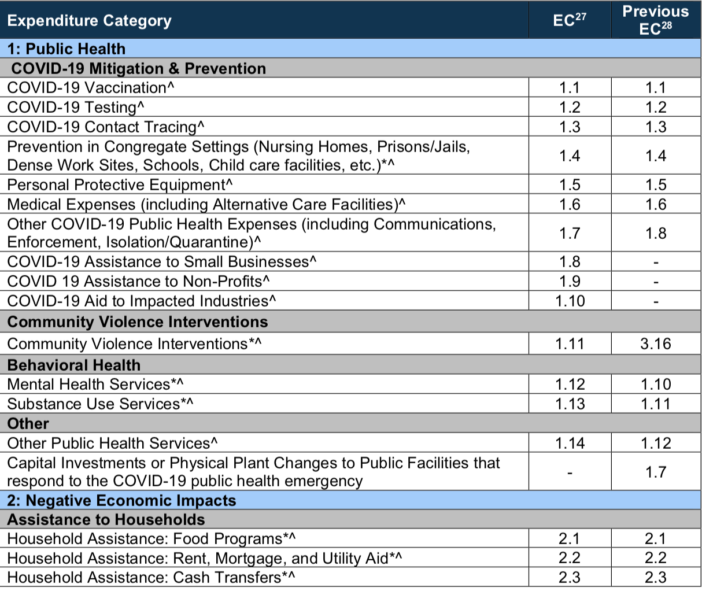
Project & Expenditure Report
Compliance Guide Lists Expenditure Categories (EC) within each broad grouping.
Local government must align each project with one (and only one) EC
All Revenue Replacement Expenditures are reported as EC 6.1 or 6.2 (if funds used for other federal grant match)
$0-$10 Million:
Report Annually on April 30
$0-$10 Million:
Report Annually on April 30

Slide 14
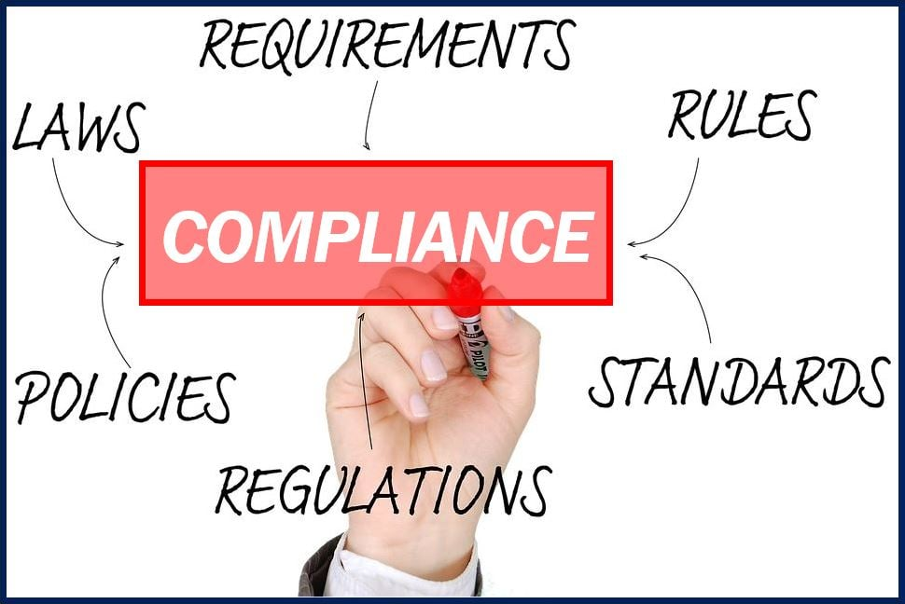
Basic Compliance
(applies to every county and municipality)
Financial Management System
Internal Controls
Civil Rights Policy
Records Retention Addendum
Eligible Use Policy
Allowable Cost Policy
Conflicts of Interest Policy
Review for other Award Terms

Slide 15
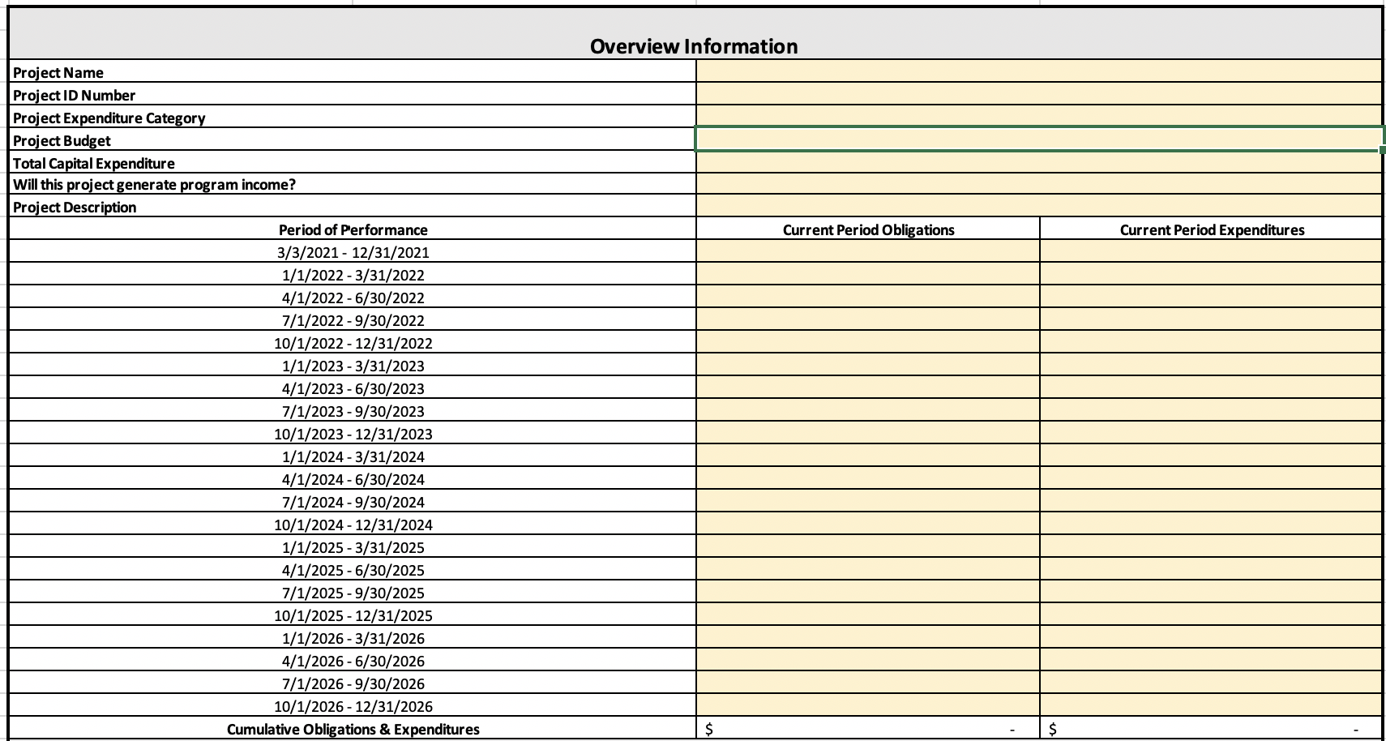
General Compliance: Financial Management
Financial administration
(2 CFR 200.302). A local government must have a financial management system that is sufficient to allow it to complete all necessary reporting requirements related to the ARP/CSLFRF award. At a minimum, a local government must track obligations and expenditures of ARP/CSLFRF funds by project and include real-time comparisons to budgeted amounts for those projects.

Slide 16
General Compliance: Internal Controls
Control Environment
Commitment to integrity & ethics
Risk Assessment
Specifies suitable objectives
Control Activities
Develops control activities
Info & Communication
Monitoring Activities
Effective oversight by leadership
Clear structure and procedures
Commitment to competence
Enforces accountability
Identifies & analyzes risk
Assesses fraud risk
Identifies & analyzes significant changes
General controls over technology
Thorough policies and procedures
Communicates expectations and control activities clearly within and outside organization
Provides sufficient training for staff
Conducts ongoing monitoring
Identifies, evaluates, and communicates deficiencies
Addresses deficiencies in a timely manner
A local government must have a written set of internal controls related to its financial transactions. The nature of these controls will vary based on the size of the unit and its staffing capacity, but there are some minimum requirements. The regulation prompts a local government to generally conform its internal controls to those that apply to federal agencies through what is known as the federal Green Book or COSO Framework. That does not mean that a local government must adopt all the specific controls that apply to federal agencies; rather, it should simply follow the same general framework for its own controls.

Slide 17
General Compliance:
Adopt and Implement these Policies
Record Retention
This policy supplements a local government’s regular records retention policy to establish procedures to retain all ARP/CSLFRF-related information for at least 5 years after the end of the award term (through December 31, 2031). (Sample policy here.)
Civil Rights Compliance
This policy reaffirms the local government’s commitment to compliance with federal civil rights laws and establishes processes for reporting potential violations and tracking complaints and resolutions. (Sample policy here.)
Eligible Use
This is a simple policy that indicates allowable and unallowable projects, based on the expenditure categories in the ARP/CSLFRF Final Rule. It requires a local government to identify staff to document and review ARP/CSLFRF expenditures. That documentation must be retained according to the record retention requirements. (Sample policy here.)
Allowable Cost
This is a more complex policy that requires a local government to do a detailed review of each cost item and ensure compliance with special limitations and documentation mandates for certain cost items. (Sample policy here.) [If using Revenue Replacement ARP/CSLFRF, there will be a more limited allowable cost review.]
Conflict of Interest
The UG requires recipients and subrecipients of federal financial assistance to maintain written standards of conduct covering conflicts of interest and governing the actions of its employees engaged in the selection, award, and administration of contracts. (Sample policy here.)

Slide 18
Implementation Tools
Roadmap for Revenue Replacement
Revenue Replacement: Eligible Use and Allowable Cost Documentation Template
Revenue Replacement: Tracking Obligations and Expenditures by Project Template

Slide 19
Revenue Replacement: What Now?
Check
Check that Sam.gov registration is current
Review or adopt
Review or adopt and implement required policies
Review or adopt
Review or adopt written internal controls
Verify
Verify financial management system or set up Excel spreadsheet
Determine
Determine best expenditure items (remember reimbursements back to March 3, 2021 allowed)
Review or prepare
Review or prepare Grant Project Ordinance for board to adopt (or amend)
Collect
Collect proper documentation and establish system to retain for required period

Slide 20
What is ARP/CSLFRF Eligible?
ADDRESS COVID PUBLIC HEALTH & NEGATIVE ECONOMIC IMPACT
Support public health expenditures, by funding COVID-19 mitigation efforts, medical expenses, behavioral healthcare, and certain public health and safety staff;
Address negative economic impacts caused by the public health emergency, including economic harms to workers, households, small businesses, impacted industries, and the public sector;
Support disproportionately impacted communities
PREMIUM PAY
Provide premium pay for essential workers, offering additional support to those who have borne and will bear the greatest health risks because of their service in critical infrastructure sectors;
Target low-and moderate- income employees or employees who face(d) added risks during pandemic
INFRASTRUCTURE INVESTMENTS
Invest in water, sewer, and broadband infrastructure, making necessary investments to improve access to clean drinking water, support vital wastewater and stormwater infrastructure, and to expand access to broadband internet.
Note that there are performance metrics and other data elements that must be met/ tracked/ reported on for many projects in these categories.
If allocation is over $10 million, likely have to spend some funds in one or more of these categories.

Slide 21
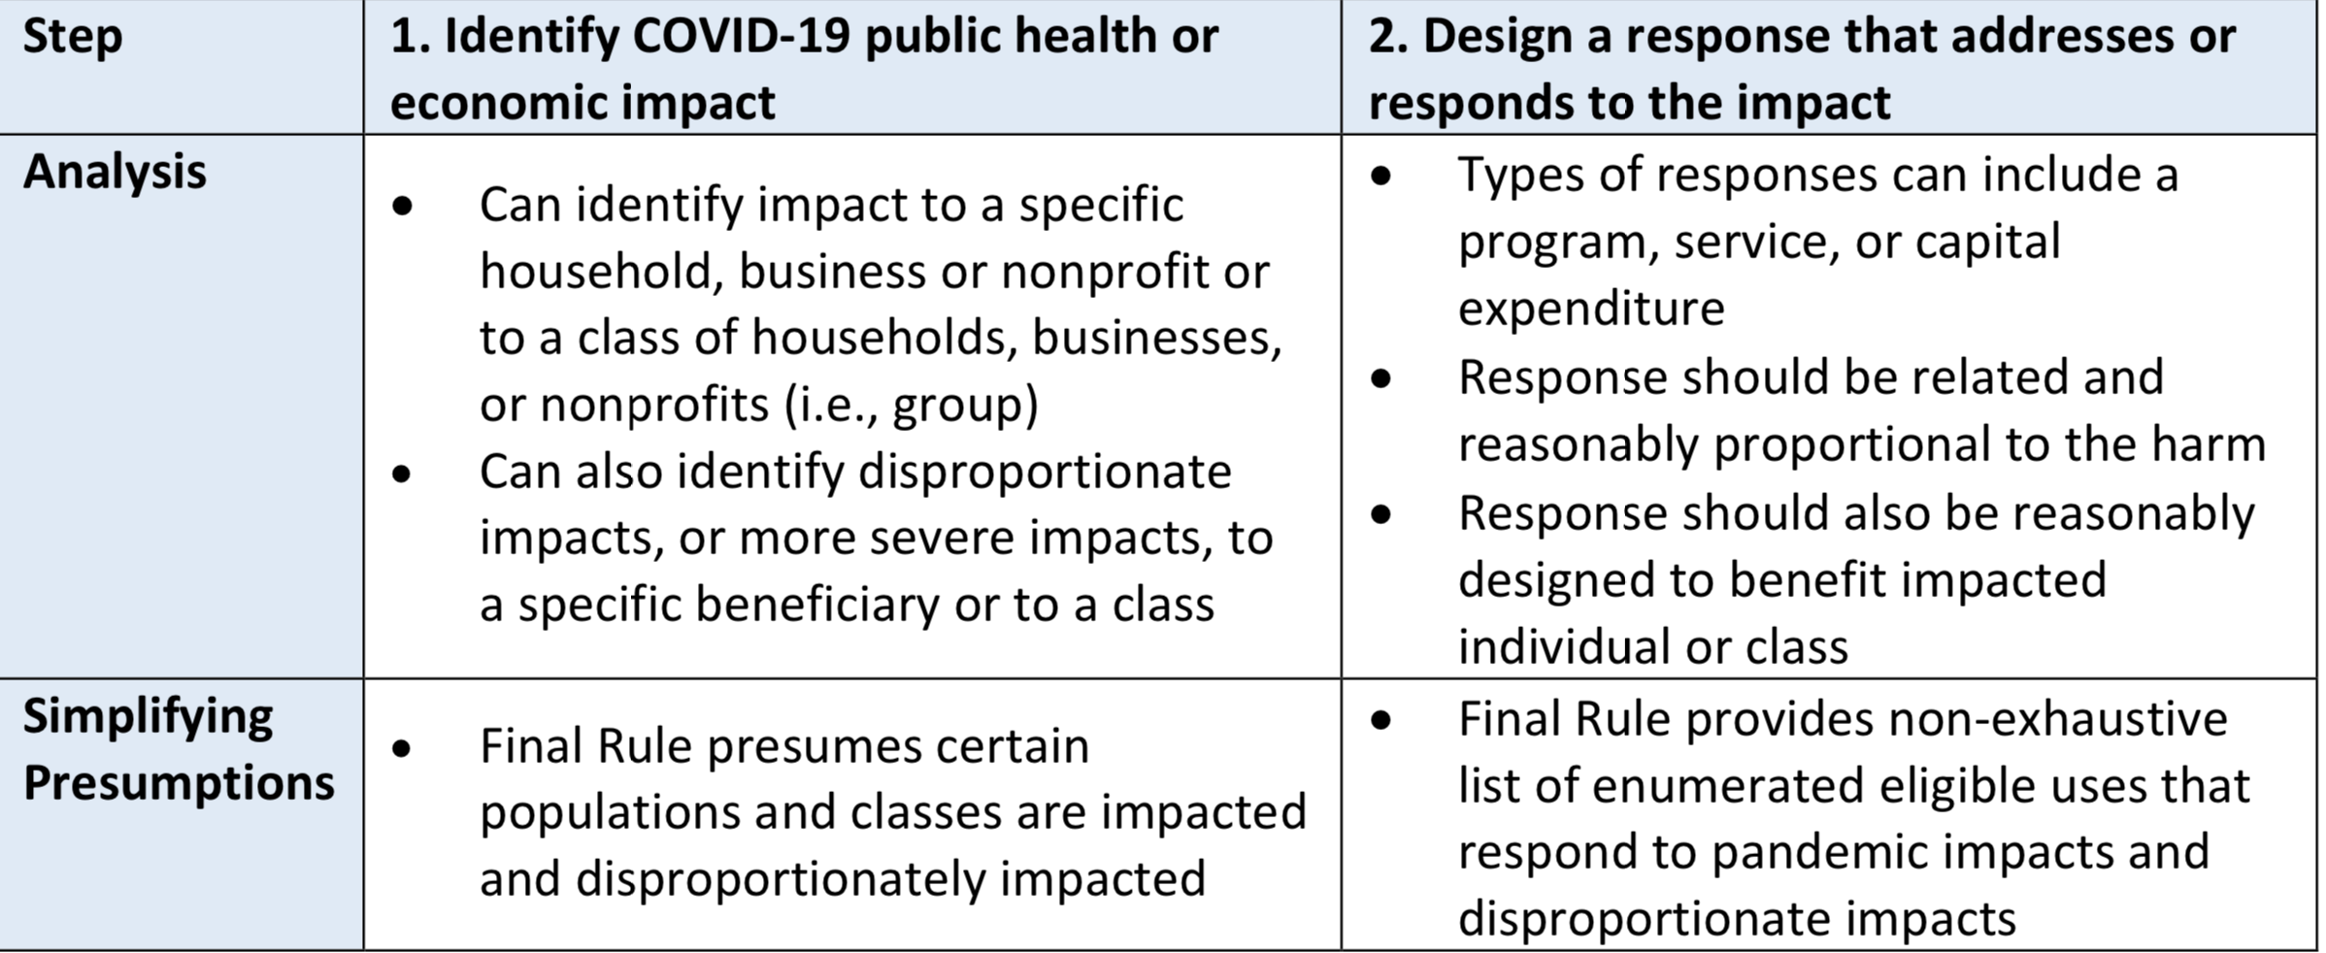
What is ARP/CSLFRF Eligible?
Identify targeted beneficiary that was harmed due to COVID and design project/ program to address that harm
ADDRESS COVID PUBLIC HEALTH & NEGATIVE ECONOMIC IMPACT
See Final Rule Overview for lists of safe harbor projects.

Slide 22
Address COVID & Negative Economic Impact
Must also clearly identify state law authority. There is broad state law authority to assist low- or moderate- income citizens and senior citizens but very limited state law authority to directly aid small businesses and nonprofits.
Who is the beneficiary?
Safe harbor beneficiary (enumerated list) or general analysis?
What is the harm (addressing COVID or its negative economic impact)?
How does proposed project address the harm?
Safe harbor project (enumerated list) or general analysis?
Is the proposed project reasonably designed to benefit and proportional response to harm?
If proposed project, involves capital over $1m, additional justification required
Evidence based?
Safe harbor related and reasonably proportional list?
Must track demographic distribution of funds
Navigating affordable housing projects under state law
(by Tyler Mulligan)

Slide 23
Address COVID & Negative Economic Impact
General Analysis
Program, service, capital expenditure eligible if LG identifies harm or impact to beneficiary or class caused or exacerbated by COVID or its negative economic impacts AND the program, service, or capital expenditure responds to the harm.
Who is the beneficiary?
Safe harbor beneficiary (enumerated list) or general analysis?
What is the issue (addressing COVID or its negative economic impact)?
How does proposed project address the issue?
Safe harbor project (enumerated list) or general analysis?
Is the proposed project reasonably designed to benefit and proportional response to issue?
If proposed project, involves capital over $1m, additional justification required
Evidence based?
Safe harbor related and reasonably proportional list?
Must track demographic distribution of funds
The final rule presumes that all enumerated eligible uses for programs and services, including COVID-19 mitigation and prevention programs and services, are reasonably proportional responses to the harm identified unless a response is grossly disproportionate to the type or extent of harm experienced.
Navigating affordable housing projects under state law (by Tyler Mulligan)

Slide 24
Public Sector Capacity & Workforce
Payroll and covered benefit expenses for public safety, public health, health care, human services, and similar employees to the extent that the employee’s time is spent mitigating or responding to the COVID-19 public health emergency;
Payroll, covered benefit, and other costs associated with programs or services to support the public sector workforce and with the LG:
  Hiring or rehiring staff to fill budgeted full-time equivalent positions that existed on January 27, 2020 but that were unfilled or eliminated as of March 3, 2021; or
  Increasing the number of its budgeted full-time equivalent employees by up to the difference between the number of its budgeted full-time equivalent employees on January 27, 2020, multiplied by 1.075, and the number of its budgeted full-time equivalent employees on March 3, 2021, provided that funds shall only be used for additional budgeted full-time equivalent employees above the recipient’s number of budgeted full-time equivalent employees as of March 3, 2021;
Costs to improve the design and execution of programs responding to the COVID-19 pandemic and to administer or improve the efficacy of programs addressing the public health emergency or its negative economic impacts
Costs associated with addressing administrative needs of recipient governments that were caused or exacerbated by the pandemic.
Note that these limitations only apply to the “purple” category expenditures. If using Revenue Replacement, may pay for any government costs, except those on prohibited list.

Slide 25
Capital Outlay for Address COVID and
Negative Economic Impact Category
If a project has total expected capital expenditures of | and the use is enumerated in (b)(3), then | and the use is not enumerated in (b)(3), then
Less than $1 million | No Written Justification required | No Written Justification required
Greater than or equal to $1 million, but less than $10 million | Written Justification required but recipients are not required to submit as part of regular reporting to Treasury | Written Justification required and recipients must submit as part of regular reporting to Treasury
$10 million or more | Written Justification required and recipients must submit as part of regular reporting to Treasury
Written justification must include the following elements:
Describe the harm or need to be addressed;
Explain why a capital expenditure is appropriate; and
Compare the proposed capital expenditure to at least two alternative capital expenditures and demonstrate why the proposed capital expenditure is superior.

Slide 26
PREMIUM PAY
May provide subaward to nonprofit fire departments, rescue squads, or similar entities to provide premium pay to their employees –must be for work that LG has state statutory authority to perform itself and that is also eligible under ARP/CSLFRF
May award premium pay to any local government employee who performed essential work during the pandemic
  Essential work is work that is performed in person with regular interactions with others (including co-workers) OR regularly handling items handled by others
  Must target low- or moderate-income employees OR be able to provide justification for including higher income employees based on their special risks due to COVID
    Employee NOT EXEMPT from FLSA overtime provisions OR
    Employee’s total wages and remuneration does not exceed 150% of the state or county average for all occupations, whichever is higher
$13 / hour & $25K total maximums
May pay retroactively back to January 27, 2020 or prospectively until December 31, 2024, but must be for work actually performed (no pre-payments)
Low- or moderate- income criteria

Slide 27
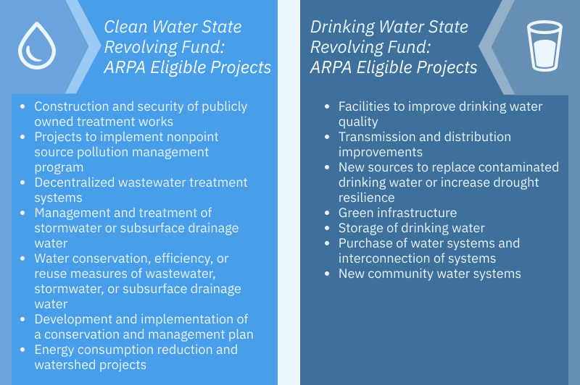
INFRASTRUCTURE INVESTMENTS
Presumed Eligible:
Projects allowed under Clean Water State Revolving Fund (CWSRF) and Drinking Water State Revolving Fund (DWSRF) programs
Must be Necessary

Slide 28
Infrastructure Investments:
Additional Eligibility
Stormwater
Culvert repair, resizing, and removal, replacement of storm sewers, etc.
Residential Wells
Testing initiatives, and treatment/remediation strategies that address contamination
Lead Remediation
Eligible regardless of water quality benefit
Infrastructure to improve access to drinking water
Replacement of internal plumbing and fixtures in schools and childcare facilities
Projects regardless of pipe material, but full length of service line must be replaced
Lead testing, lead service line replacement, water quality testing, compliance monitoring, and remediation activities
Dam & Reservoir Remediation
Primary purpose of dam or reservoir is for drinking water supply
May consider reasonable population growth
Drinking Water Infrastructure
Designed to support reasonable growth only
Must be cost-effective to achieve a minimum level of service
Must be sustainable over its estimated useful life
Must be Necessary
  Responsive to an identified need to achieve or maintain an adequate minimum level of service, which may include a reasonable projection of increased need, whether due to population growth or otherwise,
  A cost-effective means for meeting that need, taking into account available alternatives, and
  For investments in infrastructure that supply drinking water in order to meet projected population growth, projected to be sustainable over its estimated useful life.

Slide 29
General Compliance:
Adopt and Implement these Policies
Record Retention
This policy supplements a local government’s regular records retention policy to establish procedures to retain all ARP/CSLFRF-related information for at least 5 years after the end of the award term (through December 31, 2031). (Sample policy here.)
Civil Rights Compliance
This policy reaffirms the local government’s commitment to compliance with federal civil rights laws and establishes processes for reporting potential violations and tracking complaints and resolutions. (Sample policy here.)
Eligible Use
This is a simple policy that indicates allowable and unallowable projects, based on the expenditure categories in the ARP/CSLFRF Final Rule. It requires a local government to identify staff to document and review ARP/CSLFRF expenditures. That documentation must be retained according to the record retention requirements. (Sample policy here.)
Allowable Cost
This is a more complex policy that requires a local government to do a detailed review of each cost item and ensure compliance with special limitations and documentation mandates for certain cost items. (Sample policy here.) [If using Revenue Replacement ARP/CSLFRF, there will be a more limited allowable cost review.]
Conflict of Interest
The UG requires recipients and subrecipients of federal financial assistance to maintain written standards of conduct covering conflicts of interest and governing the actions of its employees engaged in the selection, award, and administration of contracts. (Sample policy here.)

Slide 30
Additional Compliance for
Purple, Green, and Blue Categories ONLY
Sign-up for FREE on-demand video instructions and sample policies for each of these requirements.
Thanks to the NC Association of Regional Councils of Government for sponsoring the course!
UG Procurement. Adopt and implement a procurement policy that complies with federal and state law requirements.
UG Property Management. Adopt and implement policy for managing, using, and disposing of real property, equipment, and supplies, acquired or improved with federal funds.
UG Subawards. Adopt and implement policy for partnership agreements with external parties.
UG Program Income. Adopt and implement policy for identifying, tracking, and re-obligating program income earned as a result of grant award.

Slide 31
Project & Expenditure Report
Compliance Guide Lists Expenditure Categories (EC) within each broad grouping. Local government must align each project with one (and only one) EC
Must track data elements for certain ECs
* Projects that local government will report on amount of funds spent on evidenced-based projects
^ Projects that local government will report on number of disproportionately impacted beneficiaries

Slide 32

Bonus Info

Slide 33
UG: Property Management
Definitions of Property
2 CFR 200.1
Computing devices: machines used to acquire, store, analyze, process, and publish data and other information electronically, including accessories (or “peripherals”) for printing, transmitting and receiving, or storing electronic information. See also the definitions of supplies and information technology systems in this section.
Equipment: tangible personal property (including information technology systems) having a useful life of more than one year and a per-unit acquisition cost which equals or exceeds the lesser of the capitalization level established by the [county/City/Town/Village] for financial statement purposes, or $5,000. See also the definitions of capital assets, computing devices, general purpose equipment, information technology systems, special purpose equipment, and supplies in this section.
Information technology systems: computing devices, ancillary equipment, software, firmware, and similar procedures, services (including support services), and related resources. See also the definitions of computing devices and equipment in this section.
Intangible property: property having no physical existence, such as trademarks, copyrights, patents and patent applications and property, such as loans, notes and other debt instruments, lease agreements, stock and other instruments of property ownership (whether the property is tangible or intangible).
Personal property: property other than real property. It may be tangible, having physical existence, or intangible.
Property: real property or personal property.
Real property: land, including land improvements, structures and appurtenances thereto, but excludes moveable machinery and equipment.
Supplies: all tangible personal property other than those described in the definition of equipment in this section. A computing device is a supply if the acquisition cost is less than the lesser of the capitalization level established by the local government for financial statement purposes or $5,000, regardless of the length of its useful life. See also the definitions of computing devices and equipment in this section.

Slide 34
UG: Property Management
Real Property
  Title vests in local government
  Must be used for ARP/CSLFRF purpose, or disposed of according to US Treasury instructions and with repayment of federal share
  Must not encumber during award term
  Must be insured in same way as other local government property
Equipment
Title vests in local government
Must be used for ARP/CSLFRF purpose, used for other federal programs, or disposed of according to US Treasury instructions and with repayment of federal share
Must not encumber during award term
Must be insured in same way as other local government property
Must be tracked in property management system (with several required data elements) and inventoried at least every 2 years
Noncompetition provision
Supplies
Must be used for ARP/CSLFRF purpose or other federal award purpose
Any inventory of unused supplies exceeding $5000 in total aggregate value, local government may retain or sell, but must compensate US Treasury for federal share
Noncompetition provision

Slide 35
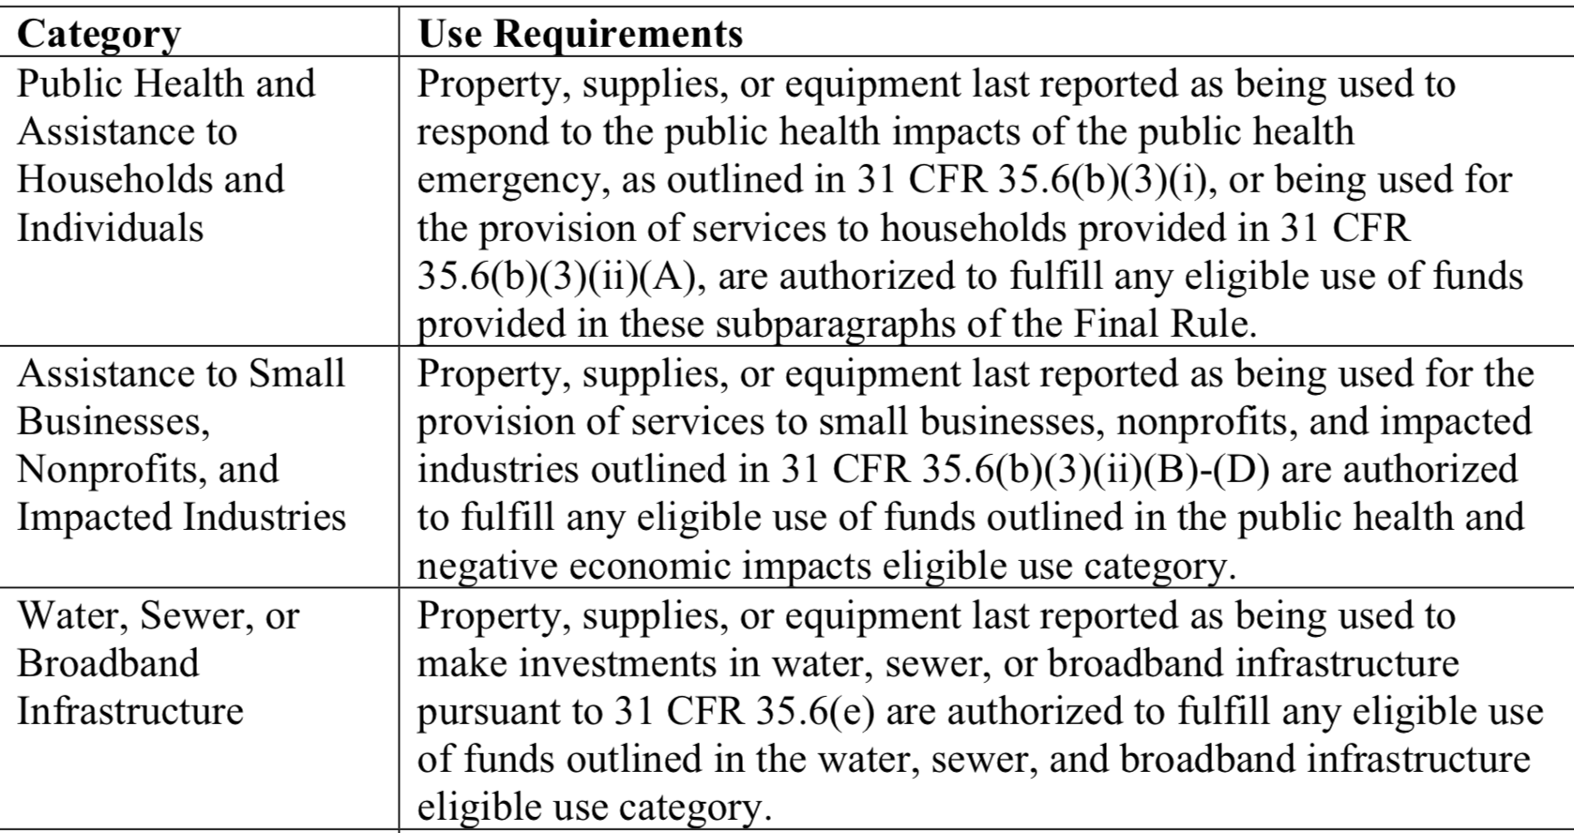
Use of Property
During Award Term
A local government “may use property, supplies, or equipment purchased or improved with [ARP/CSLFRF] funds for a purpose other than the purpose for which it was purchased or improved if such other purpose is also consistent with the eligible use requirements.”
After Award Term
“[T]he property, supplies, or equipment must be used consistent with the purpose for which it was purchased or improved or for any other eligible purpose in the same category as the purpose reported to Treasury as of the final reporting period, as set forth in the table below.”
Local governments are responsible for being able to substantiate their determinations on whether the use of an asset is authorized and maintain a record of that determination.
Local governments are not required to seek or obtain the approval of Treasury prior to changing the use within the parameters of the authorized purpose.

Slide 36
What if Sell Property or Change Use of Property Outside ARP/CSLFRF Parameters?
During Award Term
If a local government changes the use of an asset to an ineligible use or sells the asset prior to the end of the period of performance, then the local government must follow the disposition procedures in the Uniform Guidance. See 2 CFR 200.311, 200.313, 200.314, and 200.315.
After Award Term
If an asset’s use shifts outside the parameters of the eligible purpose according to the table after the grant term ends, then the local government (and any subrecipient) must follow the disposition procedures in the Uniform Guidance. See 2 CFR 200.311, 200.313, 200.314, and 200.315.
Real Property |  |  | Equipment |  |  | Supplies
Retain title and compensate US Treasury the “federal share” | Sell the property and compensate US Treasury the “federal share” | Transfer title to US Treasury or to a third party designated/ approved by US Treasury | If FMV of $5K or less, local government may retain, no compensation to US Treasury | If FMV over $5K must request disposition instructions from US Treasury. If US Treasury does not provide instructions within 120 days, may sell or use for different purpose, but must repay US Treasury “federal share” | Transfer title to US Treasury or to a third party designated/ approved by US Treasury | If there is a residual inventory of unused supplies exceeding $5,000 in total aggregate value upon termination or completion of the project and the supplies are not needed for any other Federal award, the local government must retain the supplies for use on other activities or sell them, but must, in either case, repay US Treasury “federal share”
Must get specific instructions from US Treasury on which option to take.

Slide 37
UG: Program Income
Program Income is the gross income earned by the non-Federal entity that is directly generated by a supported activity or earned as a result of the Federal award during the period of performance.
2 CFR 200.1
Program income requirements DO NOT apply to income earned from expenditures of Revenue Replacement ARP/CSLFRF funds
Program Income
Program income may apply to certain projects funded in the Necessary Infrastructure category or the Responding to COVID and Its Negative Economic Impacts category.

Slide 38
Program Income Defined
Program Income Includes
Not Program Income
Fees for services performed with grant funded programs or assets
  Income from previously unavailable services (new user fees, connection fees, other fee-for-service income)
  Incremental income from the sale of upgraded services
Income from leasing facilities or equipment
Repayment of principal and interest on loans (see ARP-specific requirements)
Proceeds from the sale of real property or equipment (must follow property management rules)
Rebates, credits, discounts, and interest earned on any of them
Taxes, special assessments, levies, fines, or other governmental revenues
Interest earned on ARP/CSLFRF funds

Slide 39
Treatment of Program Income
2 C.F.R. 200.307(e)
Deduction Method: Program income is deducted from total allowable costs to determine net allowable costs.
§ 200.307(e)(1)
Addition method applies to program income earned from expenditures of ARP/CSLFRF funds. FAQ 13.11
Addition Method: Program income is added to the funds committed to the project and expended on eligible projects.
§ 200.307(e)(2)
Program Income
Matching Method: Program income is used to finance the non-federal share of the project (i.e., meet cost-sharing commitments).
§ 200.307(e)(3)
Notes:
Use of program income. If the Federal awarding agency does not specify in its regulations or the terms and conditions of the Federal award, or give prior approval for how program income is to be used, paragraph (e)(1) of this section must apply.

Slide 40
Repayment of Principal & Interest
Loans of Infrastructure Investment ARP/ CSLFRF
Loans of Revenue Replacement ARP/CSLFRF
Program Income
Loans that mature on or before December 31, 2026
  Repayment of principal and interest shall be an addition to the total award (i.e., follow the addition method)
Loans that mature after December 31, 2026
  No obligation to track and account for the repayment of principal or interest
  See Treasury FAQ 4.9 for additional details on the treatment of loans of ARP/CSLFRF funds
Repayment of principal and interest of loan of Revenue Replacement funds exempt from program income requirements
The same applies to any contribution of Revenue Replacement funds to a revolving loan fund FAQ 4.9

Slide 41
External Contract for Construction,
Goods, or Services?
The Final Rule and Uniform Guidance group external payments of ARP/CSLFRF funds into 3 categories.
Contracts | Subawards | Beneficiary Payments
If a local government uses ARP/CLSRF funds to pay for an agreement with another entity (government, nonprofit, for profit) whereby the other entity provides goods or services for the benefit of the local government, it is a contractor relationship. The agreement is referred to as a “contract.” | If a local government uses ARP/CSLFRF funds to pay for an agreement with another entity (government, nonprofit, for profit) whereby the other entity carries out an ARP/CSLFRF eligible project instead of the local government, it is a subrecipient relationship. The agreement is a “subaward.” | If the payment is made directly to the beneficiary of an ARP/CSLFRF eligible project, it is neither a contract nor a subaward for federal regulatory purposes.
A local government must document whether an external agreement is a contract or subaward, according to this checklist.
Note that Uniform Guidance “contract” and “subaward” requirements
DO NOT APPLY to Revenue Replacement expenditures.

Slide 42




UG: Subaward Process
Local Government “should develop written policies and procedures for subrecipient monitoring and risk assessment and maintain records of all award agreements identifying or otherwise documenting subrecipients’ compliance obligations.”
Determination of relationship: Subrecipient or Contractor
2 CFR 200.331
Risk Assessment
2 CFR 200-332(b)-(c)
Formation and issuance of subaward agreement
2 CFR 200.332(a)
Post-award monitoring
2 CFR 200.332(d)-(h)

Slide 43

Subaward Vocabulary
Recipient: Local government that received ARP/CLFRF award
Pass-through Entity: Local government that provides a subaward to a subrecipient to carry out part of the ARP/CLFRF award program
Subaward: Award provided by a pass-through entity to a subrecipient to carry out part of the ARP/CLFRF award received by the pass-through entity
Subrecipient: Entity the receives a subaward from a pass-through entity to carry out part of the ARP/CLFRF award program.

Slide 44
Contract vs. Subaward
Contractor Relationship
Subrecipient Relationship
A procurement relationship
Provides goods and services within normal business operations
Provides similar goods and services to many purchasers
Normally operates in a competitive environment
Provides goods or services that are ancillary to the federal program
Not subject to compliance requirements of the federal program
An assistance relationship (LG assisting subrecipient)
Subrecipient determines eligibility of beneficiaries
Performance measured against federal program objectives
Responsible for programmatic decision-making
Adheres to applicable federal program requirements
Uses federal funds to carry out a program for public purposes specified in statutes, as opposed to providing goods or services for the benefit of the pass-through entity
Make sure to document the determination in the Checklist form.

Slide 45
Subawards
Eligibility restrictions
Award terms and prohibitions
Uniform guidance requirements
Local Government
Partner Organization
Subawards are agreements between the pass-through entity (local government) and subrecipient (partner organization) setting the terms of the subrecipient’s performance duties.
All of the ARP/CSLFRF eligibility restrictions, award terms and prohibitions, and Uniform Guidance requirements flow down to the subrecipient.

Slide 46


Recipient (Local Government) / Subrecipient Relationship
A Subrecipient must:
Provide appropriate progress reports and financial reports to the LG
  Be accountable to the LG for how it uses the federal funds provided under the subaward
  Follow applicable federal rules regarding financial mgmt, internal controls, cost principles, and audit requirements
Collect and provide financial and performance data for the recipient to include in its reports to LG
A LG must require a subrecipient to comply with – and must monitor a subrecipient for compliance with – all the conditions and restrictions that apply to the ARP/CLFRF award.

Slide 47

Subrecipient Risk Assessment
Subrecipient must permit State agency and auditors to have access to the subrecipient's records and financial statements as necessary for the State agency to meet the risk assessment & monitoring requirements
1. CHECK SAM.GOV AND DOCUMENT THAT ENTITY IS NOT DISBARRED OR SUSPENDED
2. CHECK AND ADDRESS ANY CONFLICT OF INTEREST (2 C.F.R. 200.318(c)(1))
PRIOR AWARD EXPERIENCE
How familiar is State agency with entity?
How much experience does entity have implementing federal award programs?
How does entity’s experience relate to current program size?
PRIOR AUDIT EXPERIENCE
Has entity had a single audit or other recent audits?
Have any valid audit findings been corrected or resolved?
Risk Assessment
Does entity have personnel who are familiar with federal req’ts?
Does entity have seasoned finance directors and accounting staff?
Are entity’s systems for financial mgmt., purchasing, property mgmt., and records retention in place, well designed, and operational?
STAFFING & SYSTEMS
EXTENT OF ANY FEDERAL MONITORING
Can State agency build on existing monitoring framework of other federal awards?

Slide 48
Sample Mapping of Risk Assessment to Additional Compliance
Low Risk
Periodic review of financial and performance reports
Med. Risk
Payments on reimbursement basis
High Risk
Quarterly status meetings
Other action plans established by LG
Required technical training and assistance
More detailed financial reports
Review of financial mgmt. systems and policies and procedures to ensure adequacy to meet minimum requirements
Monthly financial, performance, and compliance reports
Follow-up an ensure timely action on all identified deficiencies detected through audits, on-site reviews, and other reports from subrecipient. (Document all follow-up)
Management decisions for applicable audit findings related to this award (2 CFR 200.521)
Arranging for procedures engagement, if subrecipient not subject to Single Audit (2 CFR 200.425)
Verify audits
Withholding authority to proceed to next phase until sign off on acceptable performance
Supporting documentation for all expenditures
Additional project monitoring
Minimum req’ts
All the above PLUS
Must notify subrecipient of add’l req’ts in subaward and state reason for them

Slide 49








Subrecipient Monitoring: Required Provisions
Review financial and performance reports (quarterly basis).
Consider whether audit results or other factors necessitate adjustment to State agency records
1
5
Verify single audit compliance (if applicable). Obtain audit from Federal Audit Clearinghouse (FAC)
Consider whether enforcement actions are necessary
2
6
Document all monitoring actions and keep records of all subrecipient expenditures
3
Ensure corrective actions on deficiencies (financial or performance)
7
Issue management decisions on relevant audit findings (must issue w/in 6 months after audit report accepted by FAC)
4
Collect additional documentation if cost sharing required
8

