Slide 1
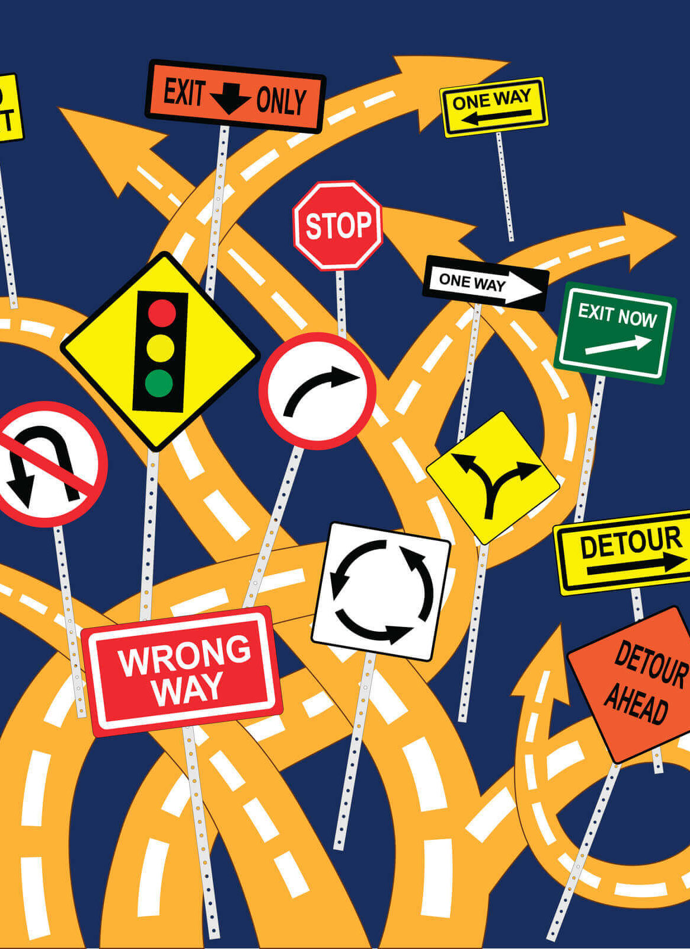
American Rescue Plan Act of 2021 Coronavirus State and Local Fiscal Recovery Fund: THE BASICS OF COMPLIANCE
Kara A. Millonzi, Robert W. Bradshaw, Jr. Distinguished Professor of Public Law and Government, UNC Chapel Hill School of Government
millonzi@sog.unc.edu
Rebecca Badgett, Assistant Teaching Professor of Public Law and Government, UNC Chapel Hill School of Government
rbadgett@sog.unc.edu

Slide 2
US Treasury Compliance Guidance
US Treasury Final Rule FAQs
US Treasury is routinely updating Final Rule FAQs, and compliance and reporting guidelines. Make sure you are relying on the most current guidance.
US Treasury Resource Page
Assistance Listing (21.027)
Final Rule
UG Compliance Supplement
SOG Resources
Coates Canons Blogs
ARP Website
US Treasury Final Rule Summary
ARP/CSLFRF
Where to go for the latest guidance on ARP/CLFRF

Slide 3
ARP/CSLFRF Spending Categories
ADDRESS COVID PUBLIC HEALTH & NEGATIVE ECONOMIC IMPACT
Support public health expenditures, by funding COVID-19 mitigation efforts, medical expenses, behavioral healthcare, and certain public health and safety staff;
Address negative economic impacts caused by the public health emergency, including economic harms to workers, households, small businesses, impacted industries, and the public sector;
Support disproportionately impacted communities
REPLACE LOST REVENUE
Replace lost public sector revenue, using this funding to provide government services to the extent of the reduction in revenue experienced due to the pandemic;
$10 million standard allowance OR formula approach
PREMIUM PAY
Provide premium pay for essential workers, offering additional support to those who have borne and will bear the greatest health risks because of their service in critical infrastructure sectors;
Target low-and moderate- income employees or employees who face(d) added risks during pandemic
INFRASTRUCTURE INVESTMENTS
Invest in water, sewer, and broadband infrastructure, making necessary investments to improve access to clean drinking water, support vital wastewater and stormwater infrastructure, and to expand access to broadband internet.
Know Your Category!

Slide 4
Federal Compliance Requirements
Award Terms | Prohibited Expenditures | Uniform Guidance (UG)
All funds obligated by December 31, 2024 & fully expended by December 31, 2026 Reporting requirements Project & Expenditure reports (quarterly or yearly, depending on size) -- Document data elements for certain EC’s Performance Plan reports (for largest units only) Civil rights compliance / nondiscrimination policy Compliance with all applicable Uniform Guidance provisions Records retention policy with retention for at least 5 years after award term ends Special audit requirements Other federal laws | NO: Pension fund contributions NO: Borrowing money NO: Financial reserves / rainy day fund NO: Settlement/judgement/consent decree NO: Undermines or discourages compliance with CDC guidelines NO: Violates conflict of interest provisions NO: Violates state law or other federal laws and regulations, including applicable Uniform Guidance | General Financial Management Internal Controls Eligible Projects Determination & Documentation Policy Cost Principles/Allowable Costs Policy Procurement, Suspension, & Debarment Policy Subaward Policy Program Income Policy Property Management Policy
Applies to ALL projects
Applies ONLY TO SOME projects and DOES NOT apply to Revenue Replacement
What local government agreed to as condition of receiving funds. Applies to ALL categories.
The Final Rule prohibits certain expenditures no matter what. Applies to ALL categories
Set of federal compliance regulations that apply to federal awards.

Slide 5
Revenue Replacement Compliance: Exempt from Some UG Provisions
Award Terms | Prohibited Expenditures | Uniform Guidance (UG)
All funds obligated by December 31, 2024 & fully expended by December 31, 2026 Reporting requirements Project & Expenditure reports (quarterly or yearly, depending on size) – Document data elements for certain ECs Performance Plan reports (for largest units only) Civil rights compliance / nondiscrimination policy Compliance with all applicable some Uniform Guidance provisions Records retention policy with retention for at least 5 years after award term ends Special audit requirements Other federal laws | NO: Pension fund contributions NO: Borrowing money NO: Financial reserves / rainy day fund NO: Settlement/judgement/consent decree NO: Undermines or discourages compliance with CDC guidelines NO: Violates conflict of interest provisions NO: Violates state law or other federal laws and regulations, including applicable Uniform Guidance | General Financial Management Internal Controls Eligible Projects Determination & Documentation Policy Cost Principles/Allowable Costs Policy (limited review) Procurement, Suspension, & Debarment Policy Subaward Policy Program Income Policy Property Management Policy

Slide 6
Compliance
Policies
Internal controls to help local officials comply with all legal requirements
Documentation
Records of decisions, transactions, justifications, and more documenting how grant funds were spent and what processes were followed
Reporting
P&E Report [$0-$10million]: recording obligations & expenditures by project
Performance Plan Report [Only for Units Over 250,000 population]
P&E Report [Over $10million]: recording obligations & expenditures by project; recording certain additional data elements for some projects; recording certain information about contractors and subrecipients
Retained by local government and (potentially) reviewed during audit process
Information provided in report(s) to US Treasury

Slide 7
ARP/CSLFRF Timing
March 3, 2021:
ARP/CLFRF Effective Date
January 27,
2020:
Pandemic Begins
May 2021:
Interim Final Rule
Premium Pay: May be applied retroactively to beginning of pandemic
Assistance Programs: May address negative impacts from beginning of pandemic
Revenue Loss: Will be calculated from beginning of pandemic. May cover expenses from March 3, 2021 onward
Water/Wastewater/Broadband: May be used for projects that started before March 3, 2021, but only for expenses after that date
Obligation means an order placed for property and services and entering into contracts, subawards, and similar transactions that require payment.
Summer 2021:
First ½ Distribution
Fall 2021:
Various Compliance Guides
January 2022: Final Rule
Summer 2022:
Second ½ Distribution
December 31, 2024:
All Funds Obligated
December 31, 2026:
All Funds Fully Expended

Slide 8
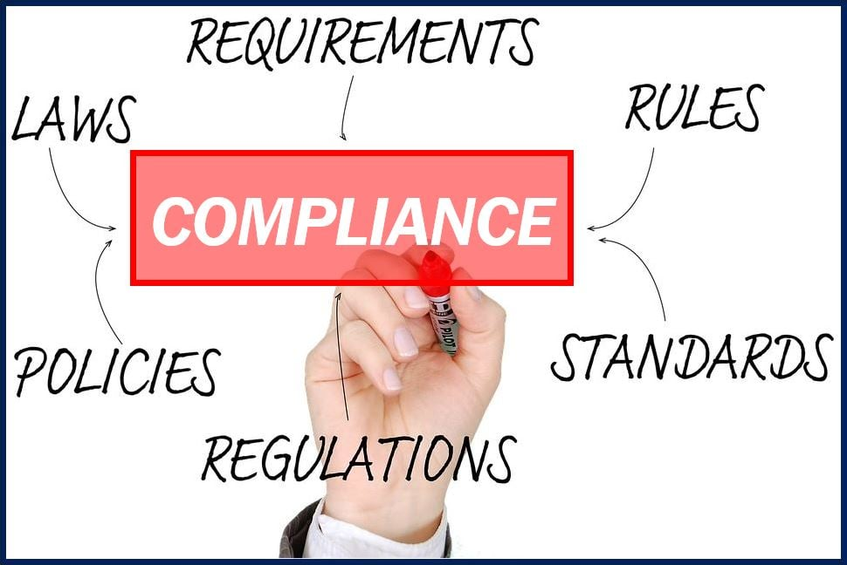
Basic Compliance (applies to every county and municipality & applies to every expenditure category)
Financial Management System
Internal Controls
Civil Rights Policy
Records Retention Addendum
Eligible Use Policy
Allowable Cost Policy
Conflicts of Interest Policy
Review for other Award Terms
Proper Budgeting
P&E Report

Slide 9
Revenue Replacement Compliance

Slide 10
Revenue Replacement: Reimbursements ONLY
1
Adopt and implement 5 BASIC policies
Adopt or amend general written internal controls
Have attorney review for compliance with Award Terms & Conditions
Identify eligible reimbursement expenditures (including salaries & benefits)
Complete eligible use and allowable cost review documentation (template here) and keep documentation of original expenditures (eg. contracts, invoices, payments, payroll records, etc.)
Adopt grant project ordinance making specific reimbursement appropriations (ARP funds are now both obligated and expended)
Do journal entry to move reimbursement cash from special revenue fund to general fund and/or enterprise fund (the cash is now unrestricted fund balance)
Track and report obligations and expenditures during reporting period (April-March) as EC 6.1 on P&E report, with brief description of reimbursement expenditures. [Or EC 6.2 if match on other federal grant]
Retain all documentation for at least 5 years after expenditure of final dollar of ARP/CSLFRF funds
2
3
4
5
Eligible reimbursement expenditures include everything except contract payments that would have violated federal conflict of interest provision, litigation/settlement payments, debt service (loan) payments or other debt-related payments, and expenditures that were specifically covered/reimbursed with other funds.
6
7
8
9

Slide 11
Revenue Replacement: Future Salaries / Benefit Expenditures
1
Adopt and implement 5 BASIC policies
Adopt or amend general written internal controls
Have attorney review for compliance with Award Terms & Conditions
Estimate salary/benefit expenditures by department
Complete eligible use and allowable cost review documentation (template here)
Adopt grant project ordinance appropriating transfer of ARP revenues to annual budget ordinance for estimated amounts that will be paid the rest of this fiscal year for salaries/benefits
Do journal entry to move cash from special revenue fund to general fund and/or enterprise fund(s)
Amend annual budget ordinance to recognize ARP revenue transfer to cover salaries/benefits for rest of fiscal year (to keep budget balanced, either reduce appropriated fund balance by same amount or add new appropriations to be paid from freed up non-grant revenues)
Retain payroll records for each covered pay period (DO NOT need individual employee effort certification forms)
Track obligations and expenditures by reporting period (April - March) and report as 6.1 EC on P&E report
Retain all documentation for at least 5 years after expenditure of final dollar of ARP/CSLFRF funds
Periodically review revenue estimates to actuals and make adjustments
Repeat each fiscal year until expend all ARP funds or grant period expires (Note that must incur all obligations by December 31, 2024)
2
3
4
5
6
7
A local government may use revenue replacement funds to cover any employee’s or official’s salaries and benefits, unless specifically covered or reimbursed with other earmarked funds.
Only documentation required is payroll records
8
9
10
11
12
13

Slide 12
Revenue Replacement: Future Other Expenditures
1
Adopt and implement 5 BASIC policies
Adopt or amend general written internal controls
Have attorney review for compliance with Award Terms & Conditions
Identify eligible project(s) and estimate costs
Complete eligible use and allowable cost review documentation (template here)
Adopt grant project ordinance appropriating ARP/CSLFRF funds for each project
Obligate and expend funds for project(s) directly out of grant project ordinance (or transfer to capital project ordinance)
Retain all documentation of contracts, agreements, invoices, expenditures, and other records
Track obligations and expenditures by reporting period (April - March) and report as 6.1 EC on P&E report
Retain all documentation for at least 5 years after expenditure of final dollar of ARP/CSLFRF funds
Periodically review revenue estimates to actuals to make adjustments to ensure all funds are obligated by December 31, 2024 and expended by December 31, 2026
2
3
4
5
Only INELIGIBLE EXPENDITURES ARE:
NO: Pension fund contributions
NO: Borrowing money
NO: Financial reserves / rainy day fund
NO: Settlement/judgement/consent decree
NO: Undermines or discourages compliance with CDC guidelines
NO: Violates conflict of interest provisions
NO: Not authorized by state law
6
7
8
9
10
11
Adv Compliance

Slide 13
General Compliance:
Adopt and Implement these Policies
Record Retention
This policy supplements a local government’s regular records retention policy to establish procedures to retain all ARP/CSLFRF-related information for at least 5 years after the end of the award term (through December 31, 2031). (Sample policy here.)
Civil Rights Compliance
This policy reaffirms the local government’s commitment to compliance with federal civil rights laws and establishes processes for reporting potential violations and tracking complaints and resolutions. (Sample policy here.)
Eligible Use
This is a simple policy that indicates allowable and unallowable projects, based on the expenditure categories in the ARP/CSLFRF Final Rule. It requires a local government to identify staff to document and review ARP/CSLFRF expenditures. That documentation must be retained according to the record retention requirements. (Sample policy here.)
Allowable Cost
This is a more complex policy that requires a local government to do a detailed review of each cost item and ensure compliance with special limitations and documentation mandates for certain cost items. (Sample policy here.) [If using Revenue Replacement ARP/CSLFRF, there will be a more limited allowable cost review.]
Conflict of Interest
The UG requires recipients and subrecipients of federal financial assistance to maintain written standards of conduct covering conflicts of interest and governing the actions of its employees engaged in the selection, award, and administration of contracts. (Sample policy here.)
BACK

Slide 14
Internal Controls Are Required Over Financial Management System
2 CFR 200.302
Accounting records must track:
Authorizations
Obligations
Expenditures
Program Income
Maintain source documentation
Paid invoices
Payrolls
Time and attendance records
Subaward agreements
Contracts
Documentation of the history of a procurement
Produce accurate, current, and complete financial reporting
Maintain records that identify the source and application of funds
Written Eligibility and Allowable Cost Policies
Compare actual expenses with budgeted expenses
Identify all Federal awards received and expended
Notes:
Non-federal entities must have procedures to protect PII and other sensitive information of federal awarding agencies or pass-through entities.

Slide 15
Internal Controls 2 CFR 200.303
The non-Federal entity must:
Establish and maintain effective internal control over the Federal award that provides reasonable assurance regarding the achievement of objectives in the following categories:
Effectiveness and efficiency of operations;
Reliable reporting; and
Compliance with applicable
laws and regulations.
Internal controls should be modeled after the guidance in the Standards of Internal Control in the Federal Government (the Green Book) or the COSO Framework.
Notes:
Internal controls provide the framework for oversight of the financial and program management functions. They also contribute to the objectives of efficient operations, compliance with laws and regulations, and reliable reporting.
EVERY recipientmust establish and maintain effective internal controls over federal awards providing reasonable assurance that we are managing the federal awards in compliance with federal statutes, regulations, and the terms and conditions of the federal awards.
Internal control framework should be based on the “Standards for Internal Control in the Federal Government” issued by the Comptroller General of the United States or the “Internal Control Integrated Framework” issued by the Committee of Sponsoring Organizations of the Treadway Commission (COSO).
Internal controls are relevant to everyone in the workplace. They include our responsibility to understand and comply with organizational policies and procedures, as well as to hold ourselves and one another accountable.
Establish and maintain effective internal controls--Provide reasonable assurance that the non-Federal entity is managing the Federal award in compliance with Federal statutes, regulations, and the terms and conditions of the Federal award. ▪
Evaluate and Monitor Compliance--Remain compliant with statutes, regulations and the terms and conditions of the Federal award. ▪
Take prompt action on audit findings-- Take prompt action when instances of noncompliance are identified including non-compliance identified in audit findings ▪
Safeguard protected personally identifiable information (PII)-- Take reasonable measures to safeguard protected personally identifiable information (PII) and other information the Federal awarding agency or pass-through entity designates as sensitive consistent with applicable Federal, state, and local laws regarding privacy and obligations of confidentiality (this includes Social Security numbers, credit card numbers, etc.)
Establish and maintain effective internal controls--Provide reasonable assurance that the non-Federal entity is managing the Federal award in compliance with Federal statutes, regulations, and the terms and conditions of the Federal award. ▪
Evaluate and Monitor Compliance--Remain compliant with statutes, regulations and the terms and conditions of the Federal award. ▪
Take prompt action on audit findings-- Take prompt action when instances of noncompliance are identified including non-compliance identified in audit findings ▪
Safeguard protected personally identifiable information (PII)-- Take reasonable measures to safeguard protected personally identifiable information (PII) and other information the Federal awarding agency or pass-through entity designates as sensitive consistent with applicable Federal, state, and local laws regarding privacy and obligations of confidentiality (this includes Social Security numbers, credit card numbers, etc.)

Slide 16
Internal Controls Apply to the ARP/CSLFRF Award Terms & UG Compliance Requirements
Internal Control System
Control Environment
Risk Assessment
Control Activities
Information + Communica-tion
Monitoring
Compliance Requirements
Eligibility
Allowable Costs/Cost Principles
Property Management
Procurement/Suspension/Debarment
Program Income
Subrecipient Monitoring
Period of Performance
Reporting
Back
Notes:
Subpart D – Post-Award Requirements
Subpart E – Cost Principles
Subpart F – Audit Requirements
Grants are subject to strict government review and must meet performance standards during the award period.. The UG contains compliance requirements that provide guidelines to ensure that all federal grants are managed consistently. Subpart F includes the requirements for the Federal Single Audit.

Slide 17
Advanced Compliance
In addition to basic compliance, local governments receiving over $10 million and spending ARP/CSLFRF outside of Revenue Replacement have additional compliance and reporting requirements
Detailed cost item regulations
Direct vs. Indirect Cost Allocation
Federal Procurement
Federal Property Management
Federal Program Income
Federal Subawards
P&E Report: Additional Data Required for Certain ECs and FFATA Info for Contractors and Subrecipients

Slide 18
Allowable Costs / Cost Principles Policy
Recipient and subrecipient must adopt and implement an allowable cost policy that addresses (1) general controls; (2) direct vs. indirect costs; and (3) specific cost items
Adopts internal controls to ensure all cost items are
allowable,
reasonable,
allocable,
consistently treated, and
properly documented
Addresses direct vs indirect cost charges
Identifies de minimis indirect rate or NICRA
Apply rate to modified total project costs
Establishes review, eligibility determination, and documentation requirements for specific cost items
UG has 55 specific cost items, some of which are allowed, some of which are allowed with limitations, and some of which are disallowed.
https://canons.sog.unc.edu/2021/12/american-rescue-plan-act-of-2021-allowable-costs-and-cost-principles-including-sample-policy-and-implementation-tools/

Slide 19
External Contract for Construction, Goods, or Services?
The Final Rule and Uniform Guidance group external payments of ARP/CSLFRF funds into 3 categories.
Contracts | Subawards | Beneficiary Payments
If a local government uses ARP/CLSRF funds to pay for an agreement with another entity (government, nonprofit, for profit) whereby the other entity provides goods or services for the benefit of the local government, it is a contractor relationship. The agreement is referred to as a “contract.” | If a local government uses ARP/CSLFRF funds to pay for an agreement with another entity (government, nonprofit, for profit) whereby the other entity carries out an ARP/CSLFRF eligible project instead of the local government, it is a subrecipient relationship. The agreement is a “subaward.” | If the payment is made directly to the beneficiary of an ARP/CSLFRF eligible project, it is neither a contract nor a subaward for federal regulatory purposes.
A local government must document whether an external agreement is a contract or subaward, according to this checklist.
Note that Uniform Guidance “contract” and “subaward” requirements
DO NOT APPLY to Revenue Replacement expenditures.

Slide 20
UG: Procurement
Written Procurement Policy!
“Must have and use documented . . . Procedures, consistent with State, local and tribal laws and regulations.” (2 C.F.R. § 200.318(a))
Local Rules
State
Law
Uniform Guidance and Agency Specific Rules
Notes:
Subpart D provides procurement standards that differ from North Carolina law.

Slide 21
Follow Uniform Guidance Procurement Methods 2 C.F.R. 200.320
Informal Procurement Methods
Micro-Purchase (under $10,000)
Small Purchases ($10,000 - $249,999)
Formal Procurement Methods
Sealed Bids
$250,000 and above for construction and service contracts
$90,000 and above for purchase contracts
Competitive Proposals
$250,000 and above AND when the sealed bid method is not appropriate
Must be used for Mini-Brooks Act services above micro-purchase threshold
Notes:
The acquisition of supplies or services, the aggregate dollar amount of which does not exceed the micro-purchase threshold.”
Micro-purchase threshold is $10,000, but local governments can increase the threshold through an annual self-certification.
Equitable distribution among qualified suppliers.
Determination that price is “reasonable based on research, experience, purchase history or other information and documents it files accordingly
2—Small Purchases
The acquisition of property or services, the aggregate dollar amount of which is higher than the micro-purchase threshold but does not exceed the simplified acquisition threshold.
Price or rate quotations must be obtained from an adequate number of qualified sources as determined by the non-Federal entity.
Determine adequate number
Keep record of quotes received

Slide 22
Document the History of ALL Procurements
UG Requires Documentation
Documentation includes:
Rationale for the method of procurement
Basis for contractor selection or rejection
Justification for lack of competition, when applicable
Basis for award cost or price
Supporting documentation includes:
Purchase orders showing quantity, cost, and model numbers
Evidence of pre-audit
Evidence of the allowable cost review
Document verification that parties are not suspended or debarred
Notes:
Authorization
Training
Management create standard forms and templates for

Slide 23
Program Income
2 C.F.R. § § 200.1
Program income is the gross income earned by the non-Federal entity that is directly generated by a supported activity or earned as a result of the Federal award during the period of performance.
Program income must be tied to grant-funded asset and only applies through December 31, 2026
Includes:
Fees for services performed
Income from previously unavailable services (new user fees, connection fees, other fee-for-service income)
Incremental income from the sale of upgraded services
Income from leasing facilities or equipment
Repayment of principal and interest on loans (see ARP-specific requirements)
Excludes:
Rebates, credits, discounts and interest earned on these
Governmental revenues (taxes, levies, fines)
Proceeds from the sale of real property, equipment, or supplies funded with ARPA/CSLFRF
Interest earned on advances of federal funds is not program income

Slide 24
Treatment of Program Income Under ARPA/CSLFRF Award
Program income may apply to:
Eligible water/wastewater projects within the necessary infrastructure category
Projects in the Responding to COVID and Its Negative Economic Impacts category
Addition Method: Program income is added to the funds committed to the project and expended on eligible projects.
§ 200.307(e)(2) & FAQ 13.11
Program income is subject to all the grant requirements, including eligible use, compliance, and obligation & expenditure deadlines
Notes:
Use of program income. If the Federal awarding agency does not specify in its regulations or the terms and conditions of the Federal award, or give prior approval for how program income is to be used, paragraph (e)(1) of this section must apply.

Slide 25
Is there Program Income?
Did we fund at least part of water / wastewater project with necessary infrastructure category ARP/CSLFRF?
Did the ARP/CSLFRF-funded water / wastewater project cause the LG to generate NEW revenues?
Are the new revenues from “fees for services” or “rental fees”?
Is there an exemption that applies (taxes, special assessments, system development fees, and similar charges)?
New Customers OR Higher Fees for Existing Customers Due to ARP/CSLFRF Project
If YES
If YES
If YES
If NO
PROGRAM INCOME

Slide 26
Property Management
Definitions of Property
2 CFR 200.1
Computing devices: machines used to acquire, store, analyze, process, and publish data and other information electronically, including accessories (or “peripherals”) for printing, transmitting and receiving, or storing electronic information. See also the definitions of supplies and information technology systems in this section.
Equipment: tangible personal property (including information technology systems) having a useful life of more than one year and a per-unit acquisition cost which equals or exceeds the lesser of the capitalization level established by the [county/City/Town/Village] for financial statement purposes, or $5,000. See also the definitions of capital assets, computing devices, general purpose equipment, information technology systems, special purpose equipment, and supplies in this section.
Information technology systems: computing devices, ancillary equipment, software, firmware, and similar procedures, services (including support services), and related resources. See also the definitions of computing devices and equipment in this section.
Intangible property: property having no physical existence, such as trademarks, copyrights, patents and patent applications and property, such as loans, notes and other debt instruments, lease agreements, stock and other instruments of property ownership (whether the property is tangible or intangible).
Personal property: property other than real property. It may be tangible, having physical existence, or intangible.
Property: real property or personal property.
Real property: land, including land improvements, structures and appurtenances thereto, but excludes moveable machinery and equipment.
Supplies: all tangible personal property other than those described in the definition of equipment in this section. A computing device is a supply if the acquisition cost is less than the lesser of the capitalization level established by the local government for financial statement purposes or $5,000, regardless of the length of its useful life. See also the definitions of computing devices and equipment in this section.

Slide 27
Property Management
Property Management Sample Policy
Real Property
Title vests in local government
Must be used for ARP/CSLFRF purpose, or disposed of according to US Treasury instructions and with repayment of federal share
Must not encumber during award term
Must be insured in same way as other local government property
Equipment
Title vests in local government
Must be used for ARP/CSLFRF purpose, used for other federal programs, or disposed of according to US Treasury instructions and with repayment of federal share
Must not encumber during award term
Must be insured in same way as other local government property
Must be tracked in property management system (with several required data elements) and inventoried at least every 2 years
Noncompetition provision
Supplies
Must be used for ARP/CSLFRF purpose or other federal award purpose
Any inventory of unused supplies exceeding $5000 in total aggregate value, local government may retain or sell, but must compensate US Treasury for federal share
Noncompetition provision

Slide 28
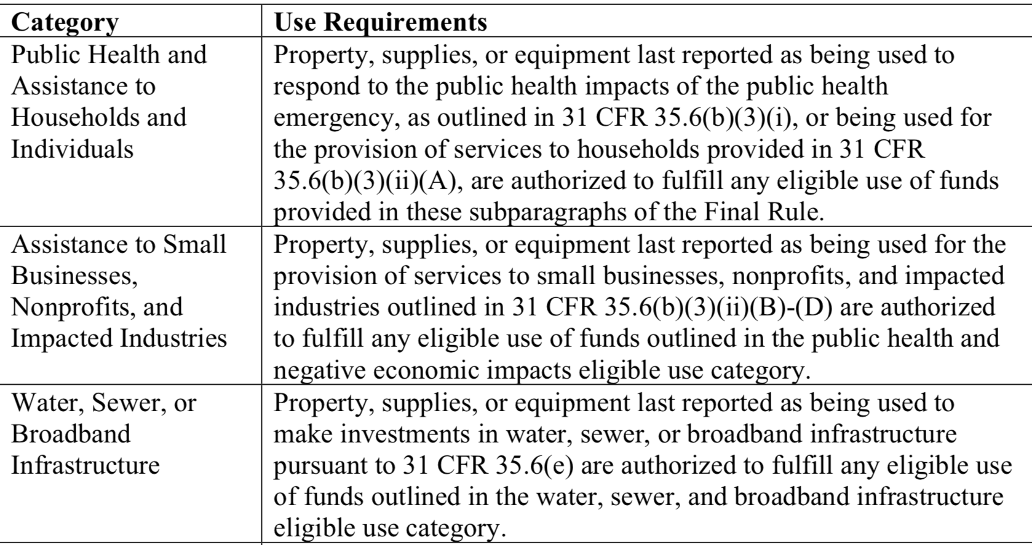
Use of Property
During Award Term
A local government “may use property, supplies, or equipment purchased or improved with [ARP/CSLFRF] funds for a purpose other than the purpose for which it was purchased or improved if such other purpose is also consistent with the eligible use requirements.”
After Award Term
“[T]he property, supplies, or equipment must be used consistent with the purpose for which it was purchased or improved or for any other eligible purpose in the same category as the purpose reported to Treasury as of the final reporting period, as set forth in the table below.”
Local governments are responsible for being able to substantiate their determinations on whether the use of an asset is authorized and maintain a record of that determination.
Local governments are not required to seek or obtain the approval of Treasury prior to changing the use within the parameters of the authorized purpose.

Slide 29
What if Sell Property or Change Use of Property Outside ARP/CSLFRF Parameters?
During Award Term
If a local government changes the use of an asset to an ineligible use or sells the asset prior to the end of the period of performance, then the local government must follow the disposition procedures in the Uniform Guidance. See 2 CFR 200.311, 200.313, 200.314, and 200.315.
After Award Term
If an asset’s use shifts outside the parameters of the eligible purpose according to the table after the grant term ends, then the local government (and any subrecipient) must follow the disposition procedures in the Uniform Guidance. See 2 CFR 200.311, 200.313, 200.314, and 200.315.
Real Property |  |  | Equipment |  |  | Supplies
Retain title and compensate US Treasury the “federal share” | Sell the property and compensate US Treasury the “federal share” | Transfer title to US Treasury or to a third party designated/ approved by US Treasury | If FMV of $5K or less, local government may retain, no compensation to US Treasury | If FMV over $5K must request disposition instructions from US Treasury. If US Treasury does not provide instructions within 120 days, may sell or use for different purpose, but must repay US Treasury “federal share” | Transfer title to US Treasury or to a third party designated/ approved by US Treasury | If there is a residual inventory of unused supplies exceeding $5,000 in total aggregate value upon termination or completion of the project and the supplies are not needed for any other Federal award, the local government must retain the supplies for use on other activities or sell them, but must, in either case, repay US Treasury “federal share”
Must get specific instructions from US Treasury on which option to take.

Slide 30
External Contract for Construction, Goods, or Services?
The Final Rule and Uniform Guidance group external payments of ARP/CSLFRF funds into 3 categories.
Contracts | Subawards | Beneficiary Payments
If a local government uses ARP/CLSRF funds to pay for an agreement with another entity (government, nonprofit, for profit) whereby the other entity provides goods or services for the benefit of the local government, it is a contractor relationship. The agreement is referred to as a “contract.” | If a local government uses ARP/CSLFRF funds to pay for an agreement with another entity (government, nonprofit, for profit) whereby the other entity carries out an ARP/CSLFRF eligible project instead of the local government, it is a subrecipient relationship. The agreement is a “subaward.” | If the payment is made directly to the beneficiary of an ARP/CSLFRF eligible project, it is neither a contract nor a subaward for federal regulatory purposes.
A local government must document whether an external agreement is a contract or subaward, according to this checklist.
Note that Uniform Guidance “contract” and “subaward” requirements
DO NOT APPLY to Revenue Replacement expenditures.

Slide 31
Subaward Process
Local Government “should develop written policies and procedures for subrecipient monitoring and risk assessment and maintain records of all award agreements identifying or otherwise documenting subrecipients’ compliance obligations.”
Sample Subaward Policy, Agreement, Risk Assessment, & Monitoring Plan
Determination of relationship: Subrecipient or Contractor
2 CFR 200.331
Risk Assessment
2 CFR 200-332(b)-(c)
Formation and issuance of subaward agreement
2 CFR 200.332(a)
Post-award monitoring
2 CFR 200.332(d)-(h)

Slide 32
Subaward Vocabulary
Recipient: Local government that received ARP/CLFRF award
Pass-through Entity: Local government that provides a subaward to a subrecipient to carry out part of the ARP/CLFRF award program
Subaward: Award provided by a pass-through entity to a subrecipient to carry out part of the ARP/CLFRF award received by the pass-through entity
Subrecipient: Entity the receives a subaward from a pass-through entity to carry out part of the ARP/CLFRF award program.

Slide 33
Subawards
Eligibility restrictions
Award terms and prohibitions
Uniform guidance requirements
Local Government
Partner Organization
Subawards are agreements between the pass-through entity (local government) and subrecipient (partner organization) setting the terms of the subrecipient’s performance duties.
All of the ARP/CSLFRF eligibility restrictions, award terms and prohibitions, and Uniform Guidance requirements flow down to the subrecipient.

Slide 34
Recipient (Local Government) / Subrecipient Relationship
A Subrecipient must:
Provide appropriate progress reports and financial reports to the LG
Be accountable to the LG for how it uses the federal funds provided under the subaward
Follow applicable federal rules regarding financial mgmt, internal controls, cost principles, and audit requirements
Collect and provide financial and performance data for the recipient to include in its reports to LG
A LG must require a subrecipient to comply with – and must monitor a subrecipient for compliance with – all the conditions and restrictions that apply to the ARP/CLFRF award.

Slide 35
Subrecipient Risk Assessment
Subrecipient must permit State agency and auditors to have access to the subrecipient's records and financial statements as necessary for the State agency to meet the risk assessment & monitoring requirements
1. CHECK SAM.GOV AND DOCUMENT THAT ENTITY IS NOT DISBARRED OR SUSPENDED
2. CHECK AND ADDRESS ANY CONFLICT OF INTEREST (2 C.F.R. 200.318(c)(1))
PRIOR AWARD EXPERIENCE
How familiar is State agency with entity?
How much experience does entity have implementing federal award programs?
How does entity’s experience relate to current program size?
PRIOR AUDIT EXPERIENCE
Has entity had a single audit or other recent audits?
Have any valid audit findings been corrected or resolved?
Risk Assessment
Does entity have personnel who are familiar with federal req’ts?
Does entity have seasoned finance directors and accounting staff?
Are entity’s systems for financial mgmt., purchasing, property mgmt., and records retention in place, well designed, and operational?
STAFFING & SYSTEMS
EXTENT OF ANY FEDERAL MONITORING
Can State agency build on existing monitoring framework of other federal awards?

Slide 36
Sample Mapping of Risk Assessment to Additional Compliance
Low Risk
Periodic review of financial and performance reports
Med. Risk
Payments on reimbursement basis
High Risk
Quarterly status meetings
Other action plans established by LG
Required technical training and assistance
More detailed financial reports
Review of financial mgmt. systems and policies and procedures to ensure adequacy to meet minimum requirements
Monthly financial, performance, and compliance reports
Follow-up an ensure timely action on all identified deficiencies detected through audits, on-site reviews, and other reports from subrecipient. (Document all follow-up)
Management decisions for applicable audit findings related to this award (2 CFR 200.521)
Arranging for procedures engagement, if subrecipient not subject to Single Audit (2 CFR 200.425)
Verify audits
Withholding authority to proceed to next phase until sign off on acceptable performance
Supporting documentation for all expenditures
Additional project monitoring
Minimum req’ts
All the above PLUS
Must notify subrecipient of add’l req’ts in subaward and state reason for them

Slide 37
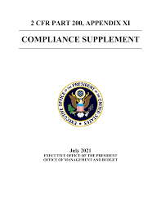
ARPA/CSLFRF & Audit Requirements
The Compliance Supplement dictates which UG compliance areas the auditors will test for each federal award.
BUT the auditee must still all award terms, even if not tested in the audit.
Compliance Supplement Appendix 2 includes examples of Control Activities
ARPA Compliance Supplement Resource
Notes:
Compliance supplement is a compendium of information available to auditors to identify the major compliance features of most federal award programs.
There are more than 220 in total, with guidance about how to audit those programs. The compliane requirements that are identified are ones that aduitors are required to check in conducting single audits. The procedures for doing so are up to them.
Part 6 focused on internal control responses to different compliance areas. This section procides

Slide 38
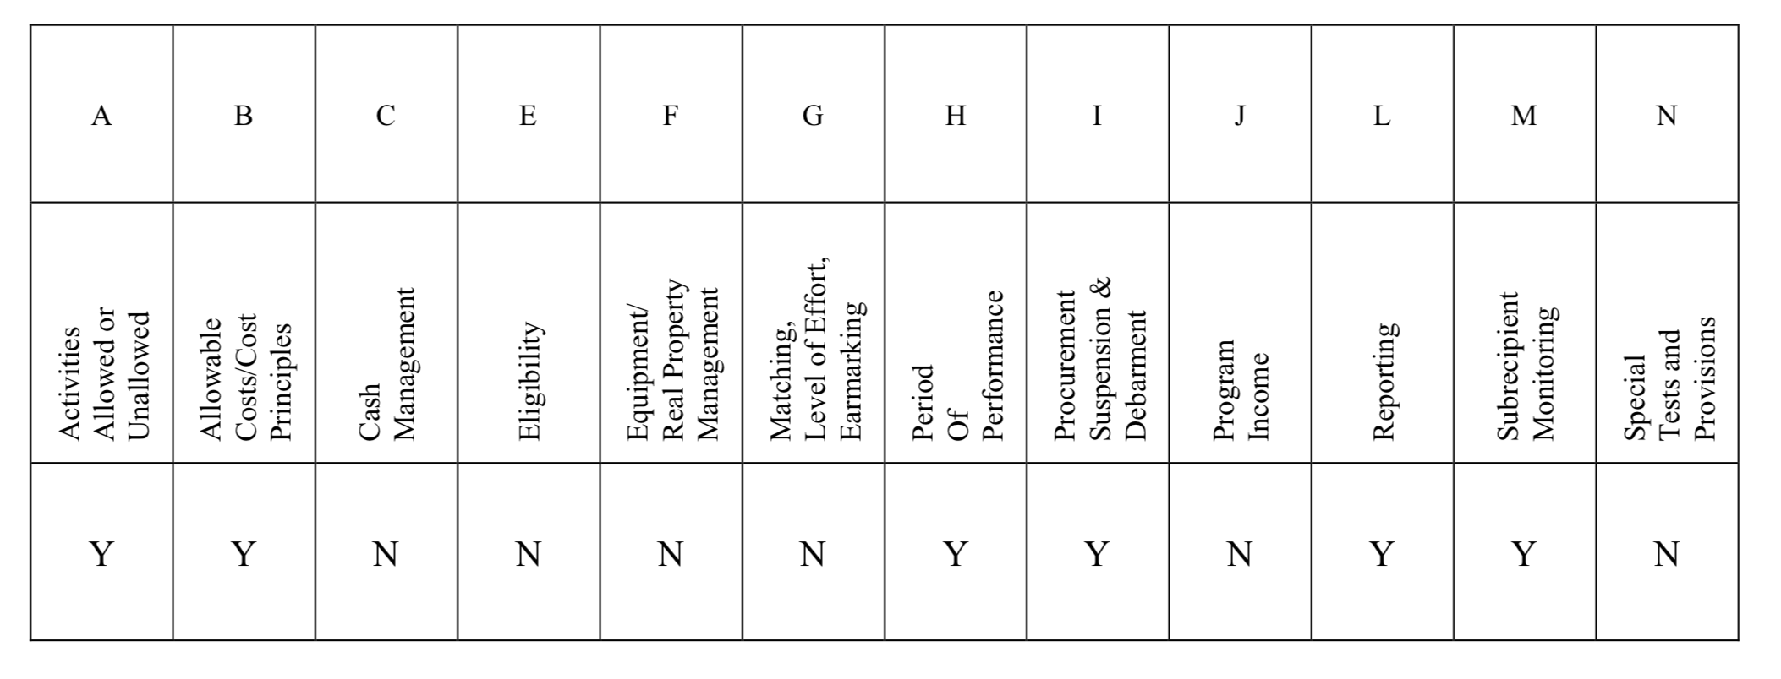
ARP/CSLFRF Alternative Compliance Examination
Not all UG compliance categories are tested, but compliance is still required
In other words, if the only reason you triggered a single audit is because of ARP/CSLFRF expenditures, and you received 10 million or less in ARP/CSLFRF funds, you are eligible for the alternative audit.
Notes:
Want to beef up internal control processes and procedures in all these areas.
If you have other fed
Auditor will issue a single compliance opinion
No required Schedule of Federal and State Awards (“SEFA”)
The submission deadline is the same as those for Single Audits
May elect to have a single audit
Compliance with the Uniform Guidance is required
eral awards, go to the compliance supplement and see what will be tested.

Slide 39
Single Audit ARP/CSLFRF Award
Not all UG compliance categories are tested, but compliance is still required
Notes:
You will need controls over all parts of the grant process, but you need really beefed up controls in the areas that will be tested in the single audit. For any federal grant, you can go to the compliance supplement and see which categories have a Y. This is for the ARP award. So we know the auditor will focus on these area of compliance.

Slide 40
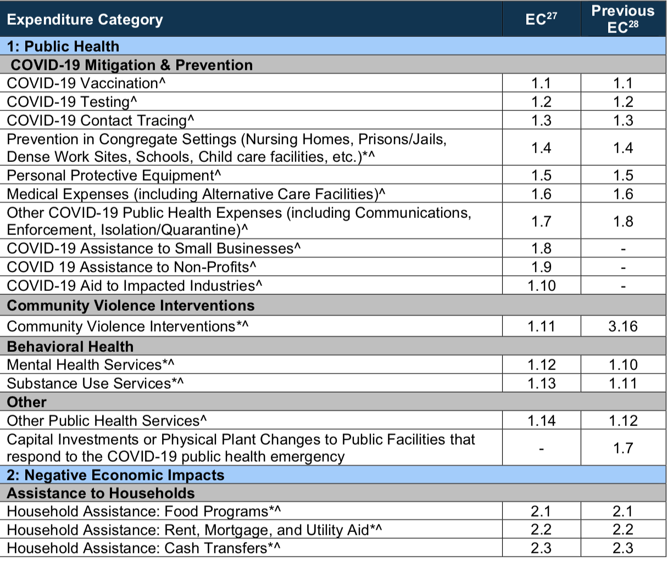
Project & Expenditure Report
Compliance Guide Lists Expenditure Categories (EC) within each broad grouping. Local government must align each project with one (and only one) EC
Must track data elements for certain ECs
* Projects that local government will report on amount of funds spent on evidenced-based projects
^ Projects that local government will report on number of disproportionately impacted beneficiaries

