Slide 1
ARPA Office Hours: UG Procurement
Rebecca Badgett
rbadgett@sog.unc.edu
Crista Cuccaro
Cuccaro@sog.unc.edu

Slide 2
Must Have Written Procurement Standards
Local Rules
State
Law
Uniform Guidance and Agency Specific Rules
Follow most restrictive rule
“Must have and use documented . . . Procedures, consistent with State, local and tribal laws and regulations.” (2 C.F.R. § 200.318(a))
For ARPA, this applies to units who received $10 million or more (or have other federal awards that require compliance with UG procurement)
Notes:
Most, but not all, categories of federal grant funds are subject to the Uniform Guidance procurement standards.
ARPA FUNDS ARE SUBJECT TO THESE STANDARDS.
General Recommendation: Assume that the UG procurement standards apply to “contracts” supported by federal grant dollars unless specific agency regulations or federal award terms and conditions state otherwise.

Slide 3
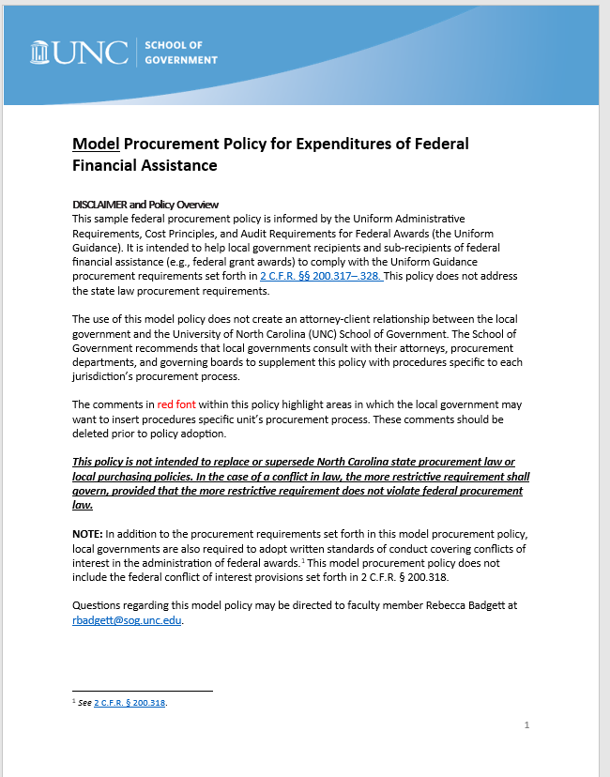
Uniform Guidance, Subpart D
Notes:
Subpart D provides procurement standards that differ from North Carolina law.

Slide 4
Written Conflict of Interest Policy
2 C.F.R. § 200.318(c)))
Must maintain written standards of conduct that cover conflicts of interests of employees, officers, & agents engaged in all stages of the procurement process (selection, award, and administration of contracts)
Applies to real or apparent conflicts of interest
Also prohibits soliciting or accepting gratuities, favors, or things of value from contractors
Must provide penalties for violations
Notes:
No employee, officer or agent shall participate in the award or administration of a contract supported by federal funds if a real or apparent COI would be involved.
A real or apparent COI = if an officer, employee or agent has a financial or other interest in the firm selected for an award, or their immediate family, or partners do.
Prohibit gifts or favors
Establish disciplinary actions for violations
The UG’s standards of conduct apply to immediate family members and partners of the public official or employee; while G.S. 14-234 applies only to the public official or employee and his or her spouse.

Slide 5
Maintain “Full and Open Competition”
2 CFR § 200.319(b)
Prohibited acts include:
Requiring unnecessary experience o
Excessive bonding
Specifying only a “brand name” product instead of allowing “an equal” product
Any other arbitrary actions
Notes:
All procurement transactions, regardless of dollar amount, shall be conducted so as to provide “maximum full and open competition” To the greatest extent feasible the [UNIT] shall avoid situations considered to be restrictive of competition, including, but not limited to, the following situations:
2 CFR § 200.319(b)
e.g., unfairly restrictive time limits for a potential supplier to respond to a request.
2 CFR § 200.319(b);

Slide 6
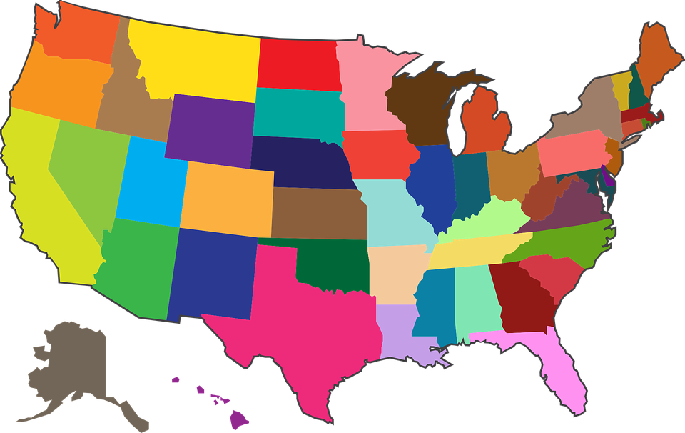
No State or Local Preferences
(2 C.F.R. § 200.319(c))
No geographic preferences may be used in the evaluation of bids or proposals
Exception: A/E service contracts may be given an in-state preference
Buy America: Must try to purchase good produced in the United States
Notes:
The [UNIT] shall conduct procurements in a manner that prohibits the use of statutorily or administratively imposed in-state or local geographical preferences in the evaluation of bids or proposals, except in those cases where applicable federal statutes expressly mandate or encourage geographic preference. When contracting for architectural and engineering (A/E) services, geographic location may be a selection criteria provided its application leaves an appropriate number of qualified firms, given the nature and size of the project, to compete for the contract.
2 CFR § 200.319(c);

Slide 7
Follow Uniform Guidance Procurement Methods 2 C.F.R. 200.320
Informal Procurement Methods
Micro-Purchase ($9,999 or less)
Need one quote
Must document that the price is fair and reasonable
Small Purchases ($10,000 - $250,000)
Adequate number of price quotes
No formal advertisement required
State law formal bidding requirements are triggered for purchase contracts costing $90,000 or more. Must follow state law sealed bidding (most restrictive)
Formal Procurement Methods
Sealed Bids ($251,000 or more)
Contracts costing $251,000 or more
Preferred method for construction
Competitive Proposals ($251,000 or more)
Used when the sealed bid method is not appropriate (e.g., service contracts)
Must be used for Mini-Brooks Act services above micro-purchase threshold. Publish RFQ. Price may not be solicited.
Notes:
The acquisition of supplies or services, the aggregate dollar amount of which does not exceed the micro-purchase threshold.”
Micro-purchase threshold is $10,000, but local governments can increase the threshold through an annual self-certification.
Equitable distribution among qualified suppliers.
Determination that price is “reasonable based on research, experience, purchase history or other information and documents it files accordingly
2—Small Purchases
The acquisition of property or services, the aggregate dollar amount of which is higher than the micro-purchase threshold but does not exceed the simplified acquisition threshold.
Price or rate quotations must be obtained from an adequate number of qualified sources as determined by the non-Federal entity.
Determine adequate number
Keep record of quotes received

Slide 8
Noncompetitive Procurements Allowed in Limited Circumstances 2 C.F.R. 200.320(c)
If a unit makes a micro-purchase.
Item is available only from a single source.
public emergency will not permit a delay resulting from publicizing a competitive solicitation.
Express authorization from a Federal awarding agency or pass-through entity.
After solicitation of a number of sources, competition is determined inadequate.

Slide 9
Are service contracts subject to UG procurement methods?
Yes. The Uniform Guidance requires that units follow the UG bidding methods when contracting for services (janitorial, maintenance, accounting).
General service contracts costing above $251,000 should be bid using the Proposals method (RFP)
A/E professional service contracts above the micropurchase threshold must be let using the RFQ process. Price cannot be solicited or used as an evaluation factor in selecting the most qualified firm.
Additional requirements apply when procuring audit services for the federal single audit

Slide 10
Procuring Audit Services
2 C.F.R. 200.509
Key Requirements
Make the objectives and scope of the audit clear to potential firms
Request a copy of the auditor’s peer review report (which the auditor is required to provide under GAGAS)
When possible, make affirmative efforts identified in 2 C.F.R. § 200.321(b) to utilize small businesses, minority-owned firms, and women’s business enterprises (“MWBE”) to conduct the audit.
DOCUMENT consideration of the following factors:
The firm’s responsiveness to the local government’s requirements for audit services
The relevant experience of the firm and/or auditor
The availability of qualified staff to conduct the audit
The results of peer and external quality control reviews
Price
Single Audit ONLY
See Blog Post by Rebecca Badgett for more details

Slide 11
Changes to Uniform Guidance!
“One study found that principal researchers on Federally funded research studies spent 42 percent of their time on administrative work and grant compliance…”
On Friday, September 22, 2023, the Office of Management and Budget (“OMB”) announced substantial pending changes to the Uniform Administrative Requirements, Cost Principles, and Audit Requirements for Federal Awards (“Uniform Guidance”), codified at 2 C.F.R. Part 200
The goal is to reduce administrative burdens for federal fund recipients
Notes:
FR version: https://www.govinfo.gov/content/pkg/FR-2023-10-05/html/2023-21078.htm
White House press release: https://www.whitehouse.gov/omb/briefing-room/2023/09/22/dollars-delivering-results-biden-harris-administration-publishes-proposed-updates-to-the-uniform-grants-guidance-to-improve-impact-of-federal-grants-and-other-financial-assistance/

Slide 12
Proposed Changes to Uniform Guidance https://www.govinfo.gov/content/pkg/FR-2023-10-05/html/2023-21078.htm
Increase the single audit threshold from $750,000 to $1,000,000
Replace the term “non-Federal entity” with recipient, subrecipient, or both to eliminate confusion, but this change does not modify the scope of applicability
Modify definitions for “intangible property,” “real property,” “recipient,” and “subaward,” among others
Remove prohibition on geographic preferences
Discontinue “small purchase” terminology and change it to “simplified acquisitions”
Modify cost price analysis to remove 2 C.F.R. 200.324(b), which requires negotiation of profit as a separate element of price for each contract in which there is no price competition
Remove requirement that sealed bids must be opened in public

Slide 13
Changes to Uniform Guidance Expected Timeline?
OMB will publish the official proposed version in the Federal Register on October 5
The public will be able to comment on the revisions for 60 days, until December 4
After the public comment period, the OMB will consider comments and publish its final rule in the Federal Register
The Final Rule generally takes effect no less than 30 days after publication

Slide 14
We’ve received bids from a local contractor and an out-of-state contractor to perform construction. We want to support the local contractor—may we include a local preference when evaluating bids?
No. 2 CFR § 200.319(c) prohibits state or local geographic preferences in the evaluation of offers, unless the grant award terms mandate or encourage geographical preference.
However, geographic location may be a selection criterion for A/E service contracts if including the preference will leave an appropriate number of qualified firms to compete for the contract.
State law: Pursuant to N.C.G.S. § 143-64.31, local governments must afford an in-state preference to A/E firms, but such preference is only allowed to the extent that the non-resident bidder is afforded a similar preference by their home state.
Notes:
2 CFR § 200.319(c) prohibits the use of statutorily or administratively imposed state or local geographic preferences in the evaluation of offers, except in cases where a federal statute specifically mandates or encourages geographical preference (for example, a geographic preference would be permissible if the federal statute adopting a new federal grant program provided for such preference). There is one exception to the prohibition of local preferences. When contracting for architectural and engineering services, geographic location may be a selection criterion if including it will leave an appropriate number of qualified firms to compete for the contract. Pursuant to N.C.G.S. § 143-64.31, local governments are required to grant a preference to A/E firms located within the state of North Carolina, but only to the extent that the non-resident bidder is afforded a similar preference by their home state . Notably, state law does not provide a preference for cities or counties to select firms closest to them—the preference extends to any A/E firm within the state.

Slide 15
May a contractor or firm that prepares the bid specs still bid on the project?
No. Contractors or firms that develop or draft contract specifications, statements of work, invitations for bids and/or requests for proposals must be excluded from competing for the underlying procurement. 2 C.F.R. 200.319(b).
Notes:
In an effort to reduce any unfair competitive advantage,

Slide 16
Can we make purchases from group purchasing programs?
Maybe – the answer depends on the facts
Group purchasing programs must follow UG requirements
FEMA Guidance: “Any applicant that decides to use a cooperative purchasing program document and explain how its use of the program complied with all federal procurement standards and applicable, state, tribal, and local procurement rules and policies.”
Notes:
Cooperative purchasing involves the purchase of goods at a pre-negotiated rate or price from a seller that participates in a cooperative purchasing program. While cooperative purchasing is allowed under North Carolina state law, units should exercise caution when using these programs to make purchases using federal award funds. Notably, the Uniform Guidance does not expressly prohibit cooperative purchasing. However, FEMA has issued guidance that seems to disfavor the use of cooperative purchasing programs because it is difficult to know if a program has complied with the UG procurement requirements when making purchases. The guidance suggests that “any applicant that decides to use a cooperative purchasing program document and explain how its use of the program complied with all federal procurement standards and applicable, state, tribal, and local procurement rules and policies.” To summarize, the juice may not be worth the squeeze—and use with extreme caution.

Slide 17
What is a price or cost analysis?
Contracts costing above $250,000 require an independent cost or price estimate PRIOR to receiving bids or proposals
This requirement extends to contract modifications (change orders)
The method and degree of analysis is dependent on the facts
But as a starting point, the non-Federal entity must make independent estimates before receiving bids or proposals
2 C.F.R. 200.324
Notes:
Some form of price or cost analysis should be performed in connection with every procurement action. The Uniform Guidance stipulates that a price or cost analysis must be performed before receiving any bids or proposals for every procurement transaction, including contract modifications, estimated to exceed the simplified acquisition threshold of $250,000. This means that a unit must independently evaluate price before a procurement is advertised—it may not simply evaluate the pricing quoted by a seller or included in a contractor’s bid or proposal.
It does not tell you how to do that. So there is some discretion. The goal isto establish a reasonable price for goods or services prior to a procurement action,

Slide 18
Price Analysis = Process for determining a fair and reasonable price for an item or service
Step 1: Create an independent price estimate
Methods to inform a price estimate include:
Catalog pricing
Market price comparison
Historical pricing/actual costs previously incurred
Step 2: Compare prices of bids/quotes received (e.g., dollars per pound, per square foot, per hour, etc.) and highlight significant inconsistencies that warrant additional pricing inquiry.
Notes:
Price analysis. A price analysis is the preferred method to analyze the price options for a product. It is the process of deciding whether a price for a particular product is fair and reasonable. A non-federal entity may use any of the below methods to help inform a reasonable price estimate.
Catalog pricing: When a seller has a published or established price list or catalog that is available to the general public, the pricing therein can be used to establish a reasonable price.
Market price comparison: The non-federal entity may get quotes from several sources and compare the pricing to establish a reasonable price estimate.
Price history: The non-federal entity may review historical pricing if it has previously purchased the same item. Changes in quantity, quality, delivery schedules, the economy may cause price variations. A copy of the previous purchase orders or other supporting documentation should be provided to support the estimate.

Slide 19
Cost Analysis = Evaluation of separate cost elements of a contract
Step 1: List all potential elements of the contract
Direct labor hours
Labor rates for each labor category
Materials/equipment
Subcontractors
Profit
Other direct costs
Step 2: Prepare an independent cost estimate
Actual costs previously incurred previously for same or similar work
Ask other jurisdictions what they paid for similar work
Call contractors to get an idea of market prices for cost elements
Step 3: Review bid/proposals
Bids/proposals should come in close to the price determined in the cost analysis. Investigate any discrepancies.

Slide 20
UG Procurement Compliance Tips
Adopt a procurement policy that includes documented procurement procedures consistent with state, local, and federal laws and regulations.
Maintaining written standards of conduct governing covering conflicts of interests of employees engaged in the selection, award and administration of contracts.
Document and maintain records to document the history of procurements.
Ensure compliance with state procurement and contracting law and abide by local procurement requirements, when applicable (most restrictive rule)
Document any decision to use noncompetitive procurement 2 CFR 200.320(c).
Perform a cost or price analysis with every procurement action in excess of the simplified acquisition threshold, including contract modifications.
Provide for full and open competition.
Ensure that every purchase order or other contract includes the applicable provisions required by 2 CFR 200.327 and described in Appendix II of 2 CFR 200. Contract clauses available on SOG ARP/CSLFRF website
Adopt process to verify that a contractor is eligible by reviewing the suspended and debarred list on SAM.gov
Comply with HUB requirements/Minority and Women-Owned Business requirements

Slide 21
Does the UG specify a process to purchase real property?
No. Capital expenditures for buildings and land are generally unallowable as direct charges. 2 C.F.R. 200.439. However, Treasury regulations specifically allow land acquisition and the purchase of other capital assets to support certain eligible uses.
Title vests with the NFE upon acquisition
Insurance is required
Must report on real property on an annual basis using Standard Form 429.
Must follow ARPA’s eligible use requirements
During the award period, property may be used for any category
After the award period, the use must be consistent with the purpose for which the property was purchased or improved or for any other eligible purpose in the same category

